Slide 1


Slide 2






Trainer Profile
VENKATA SUBBARAO B Corporate Trainer UI | UX | JAVA Full Stack | Architect | Cloud | DevSecOps | SRE | DS | ML | AI | SOFT SKILLS
Cloud & Other Platforms
AWS, AZURE, GCP, Solution Architect,
DevSecOps, SRE
Front End
ES.Next, JavaScript, React, React Native, Vue, Angular Ext JS, UXD, UI , HTML, CSS, Bootstrap, Tailwind CSS, SASS, Wire Framing , Low & High Fiddle Design, RWD, PWA …
INTEL
RAKUTEN
PANLEARN
TECHWORLDLOGICS
THINK INFINITY
COMCAST
Back End
DBS
MSYS
IMARTICUS
GENPACT
CLOUDTHAT
UST-GLOBAL
JAVA, Spring Boot, Node, ExpressJS, PHP, Python, SQL(MySQL, PgSQL), NoSQL (Mongo, Firebase, Elasticsearch, Cassandra, Couchbase), API
MANIPAL PRO
COGNIZANT
JIGSAW ACADEMY
TELSTRA
UNEXT
BAJAJ FINSERVE
HONDA USA
CRIO.DO
ETEAMINC
PROBITS
MANTT
AWIGN
MYYESM
Miscellaneous Tools
ANTHEM
MAZENET
TATA SED
ADVAITH TECHNOLOGIES
COLORS SOFT
Docker, Kubernetes, Jenkins, Kafka, Ansible, Terraform, SonarQube, Selenium, Atlassian Stack, Grafana, GraphQL, ELK Stack, Git, SVN, CVS, Redux, MobX, Thunk, Saga, Figma, Adobe XD, Karma & Jasmine, Protractor, Jest, SonarQube, Photoshop, Illustrator, Digital Marketing, Agile Scrum …
TRAINING CURVE
6BENCHES
EDUPINNACLE
AIMS MBA COLLEGE
VERZEO
INVENTATEQ
CODING SUPER STAR
VSN TRADERS
IMPACT FOUNDATION
CRAYONZE
https://www.linkedin.com/in/bvsrao-venkat-4014133b/

Slide 3
What is Graph?

Slide 4
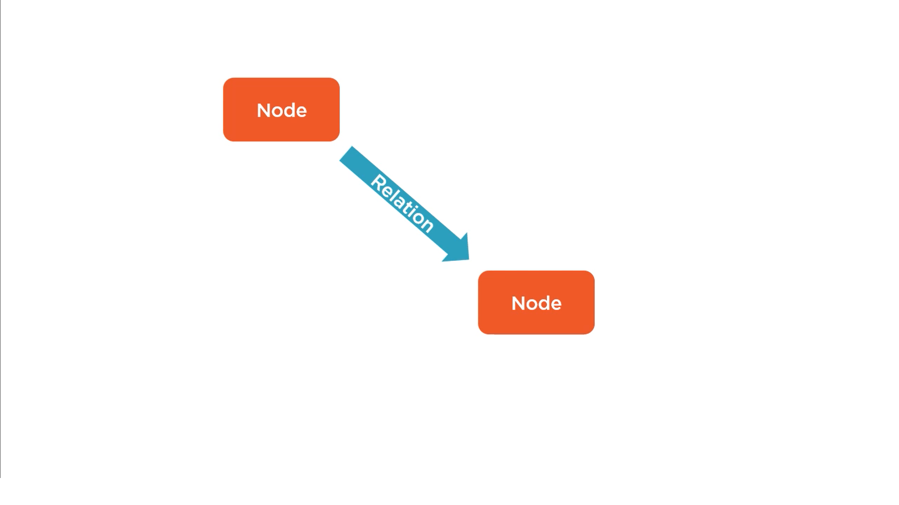

Slide 5


Slide 6
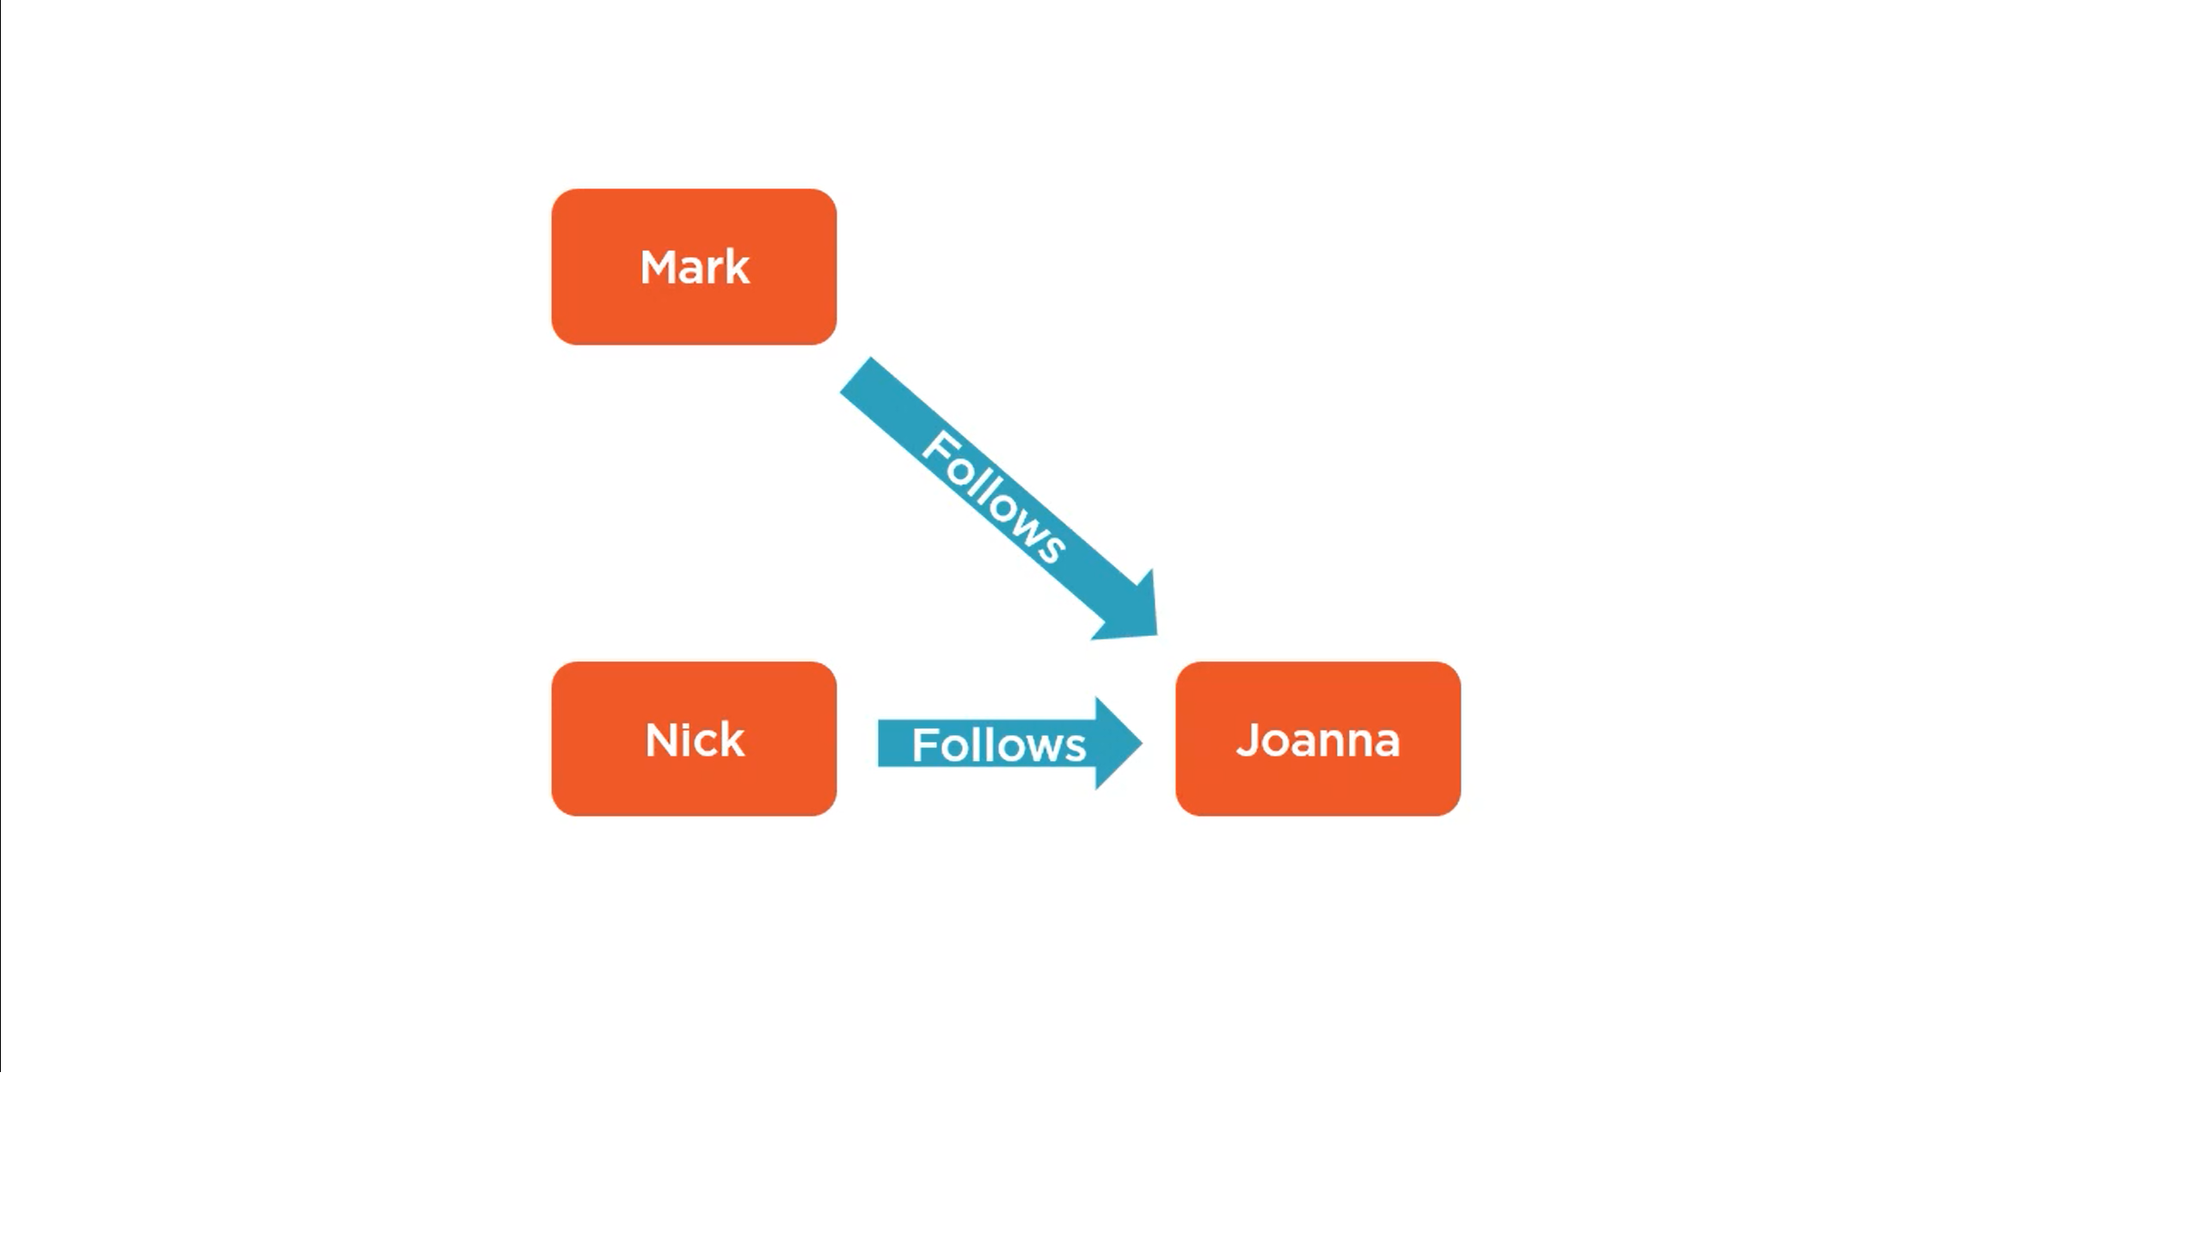

Slide 7
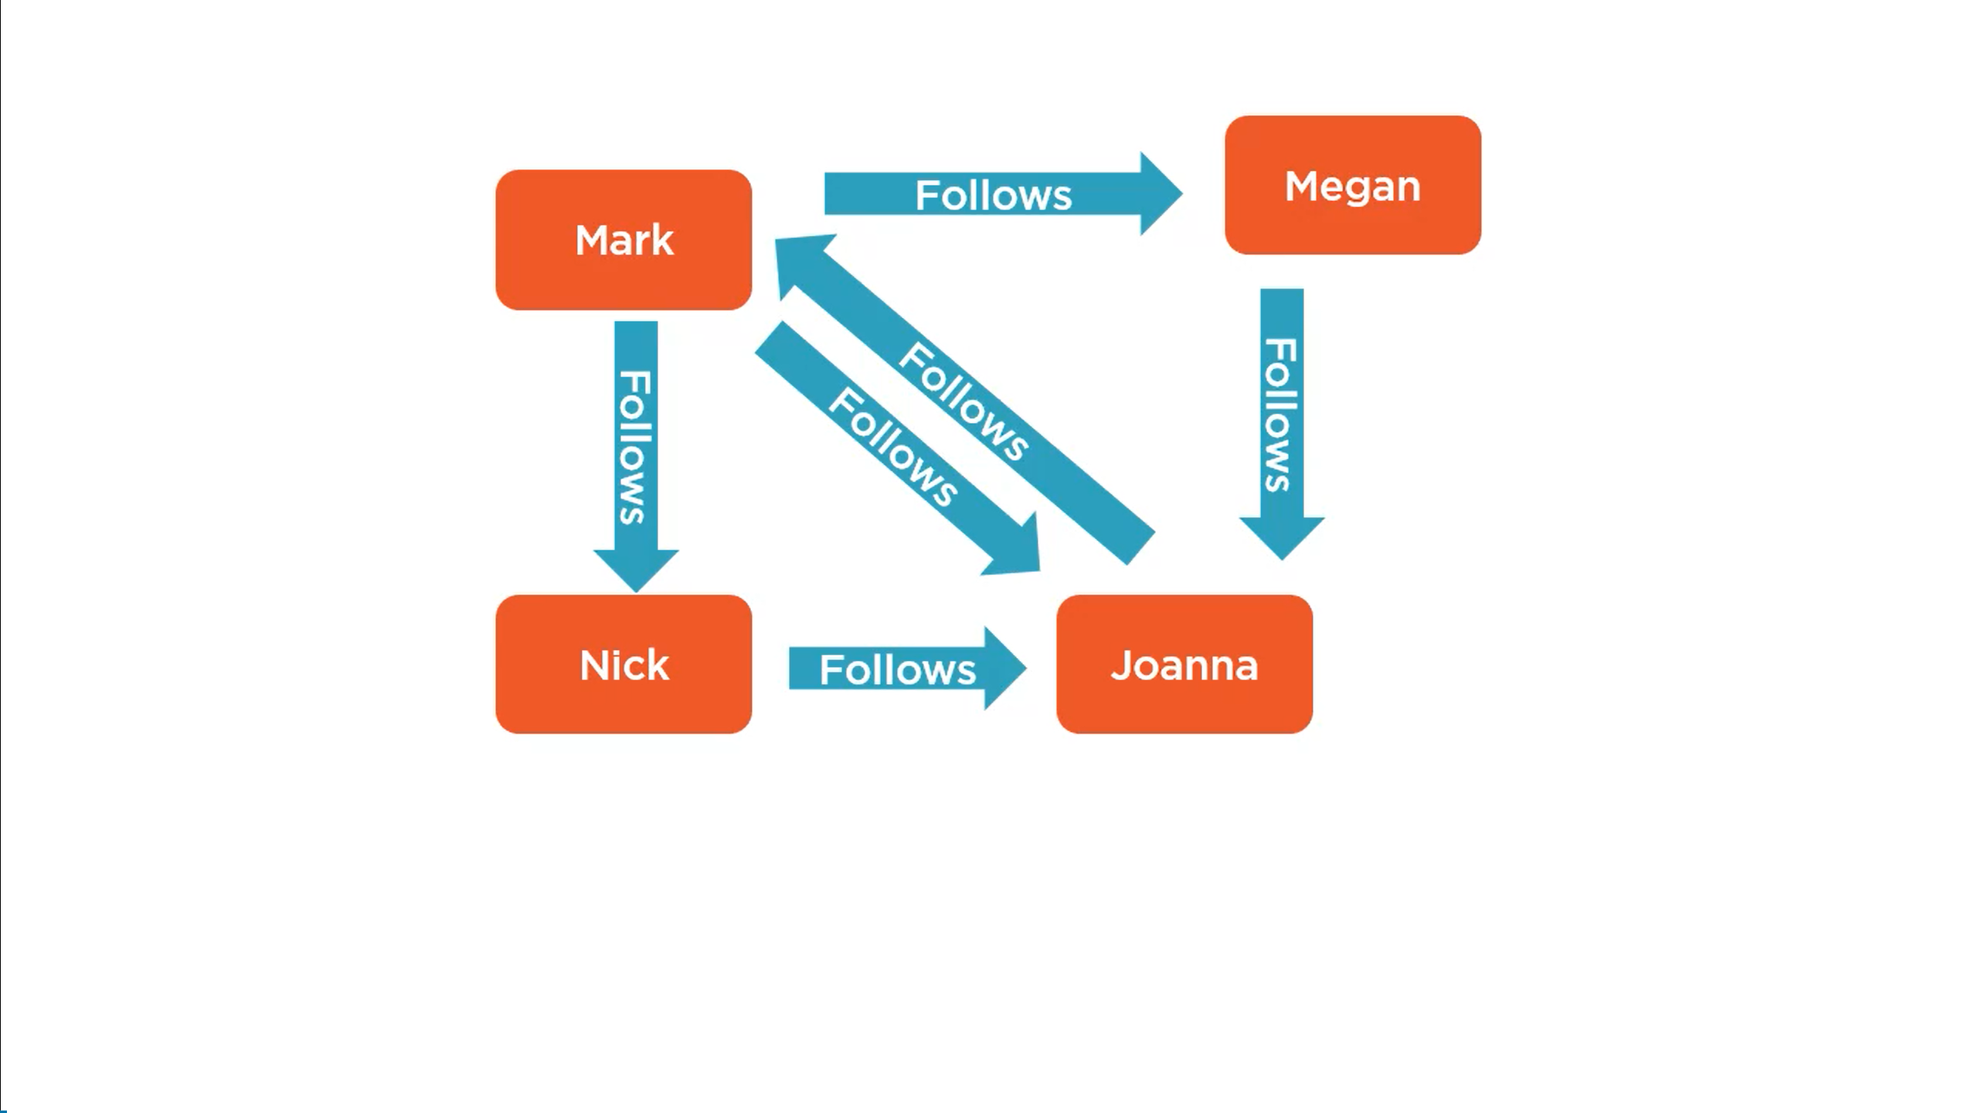
A collection of nodes and relationships together is called Graph

Slide 8
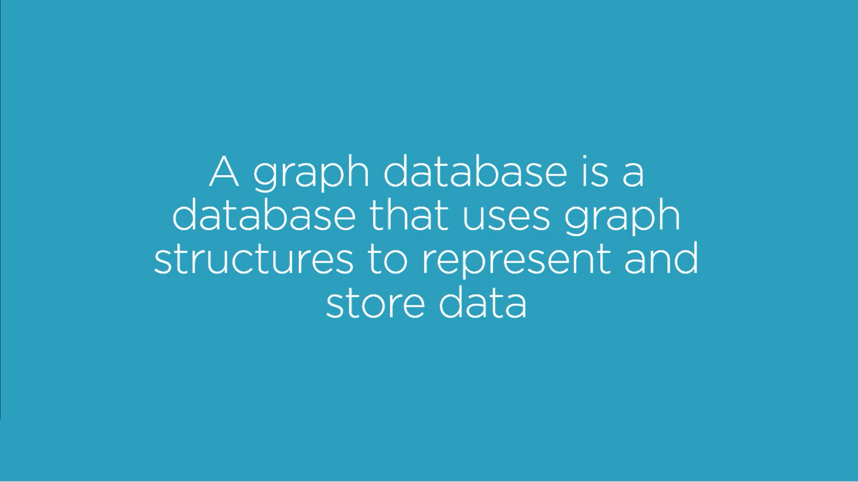

Slide 9
Graphs & Graph Databases
Easily extendable and expandable
Friendly to the human brain
Whiteboard compatible
All about relationships
Performance
Flexibility
Agility
Query languages (Supports one or more ql)

Slide 10
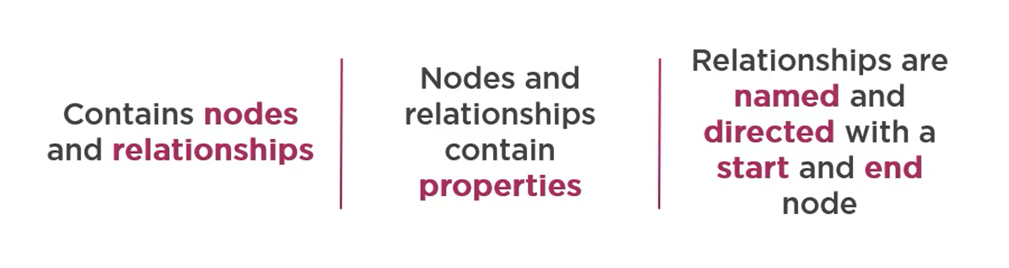
Property Graph Model

Slide 11
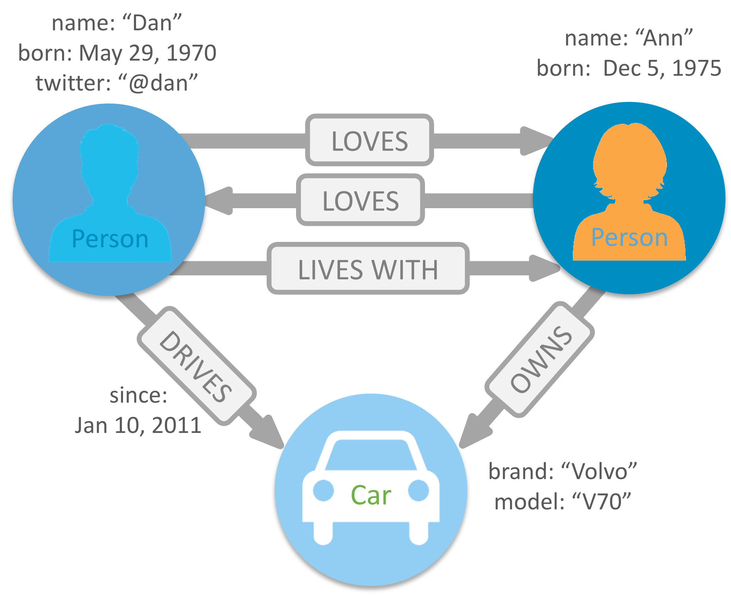
We live in a connected world, and understanding most domains requires processing rich sets of connections to understand what’s really happening. Often, we find that the connections between items are as important as the items themselves.

Slide 12
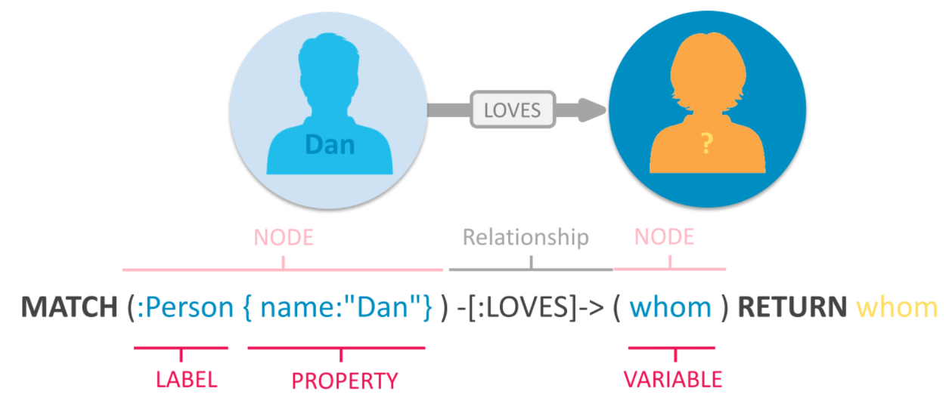
Building blocks of the property graph model

Slide 13
Nodes are the entities in the graph.
Nodes can be tagged with labels, representing their different roles in your domain. (For example, Person).
Nodes can hold any number of key-value pairs, or properties. (For example, name)
Node labels may also attach metadata (such as index or constraint information) to certain nodes.

Slide 14
Relationships provide directed, named, connections between two node entities
Relationships always have a direction, a type, a start node, and an end node, and they can have properties, just like nodes.
Nodes can have any number or type of relationships without sacrificing performance.
Although relationships are always directed, they can be navigated efficiently in any direction.

Slide 15
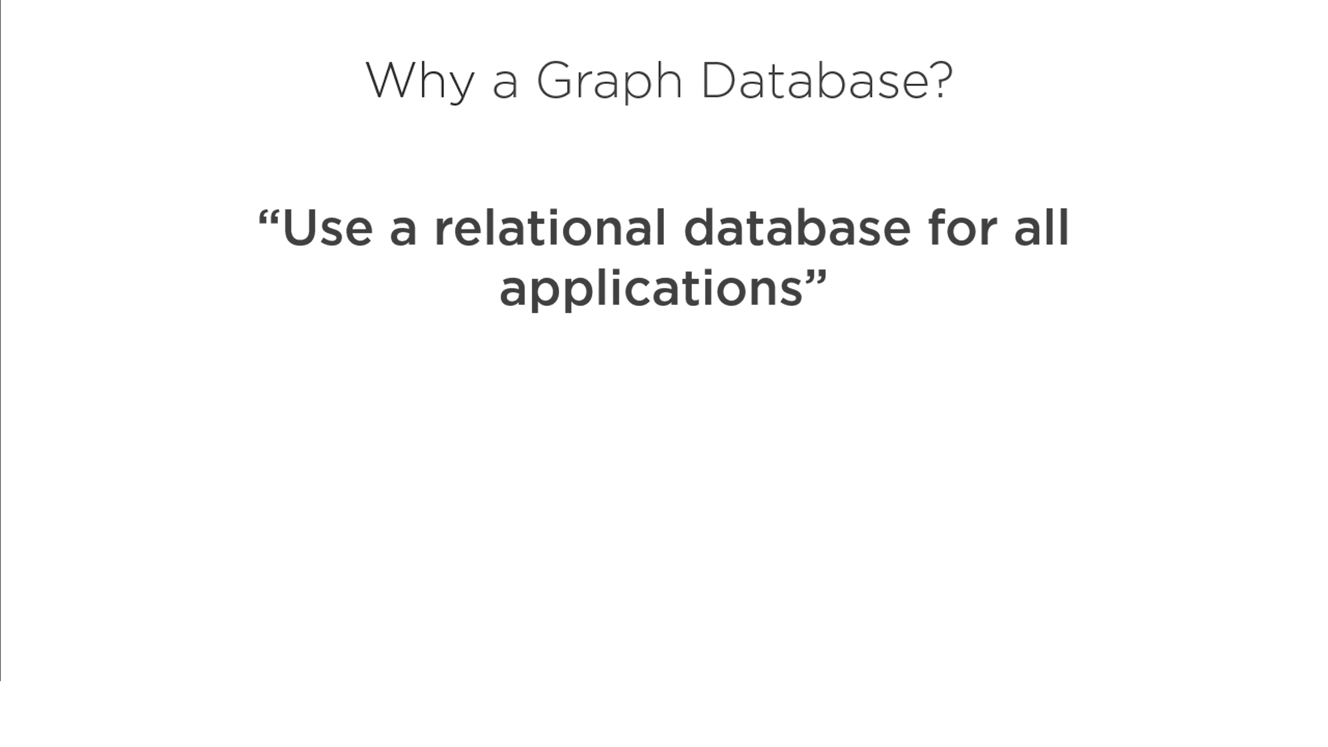

Slide 16
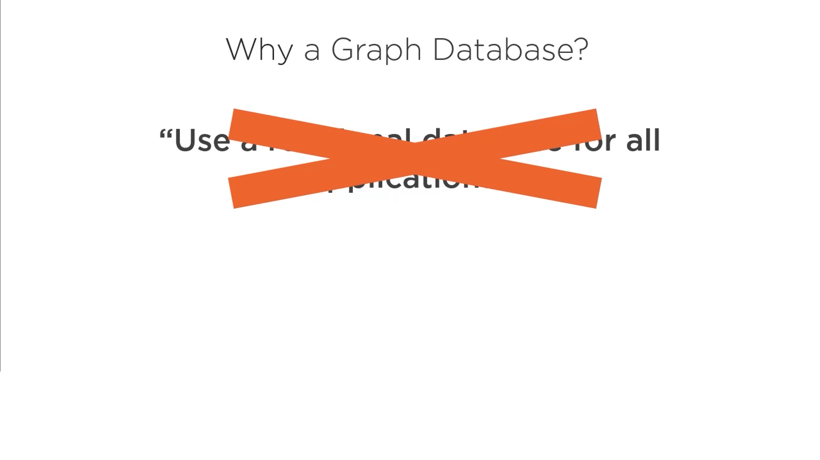

Slide 17
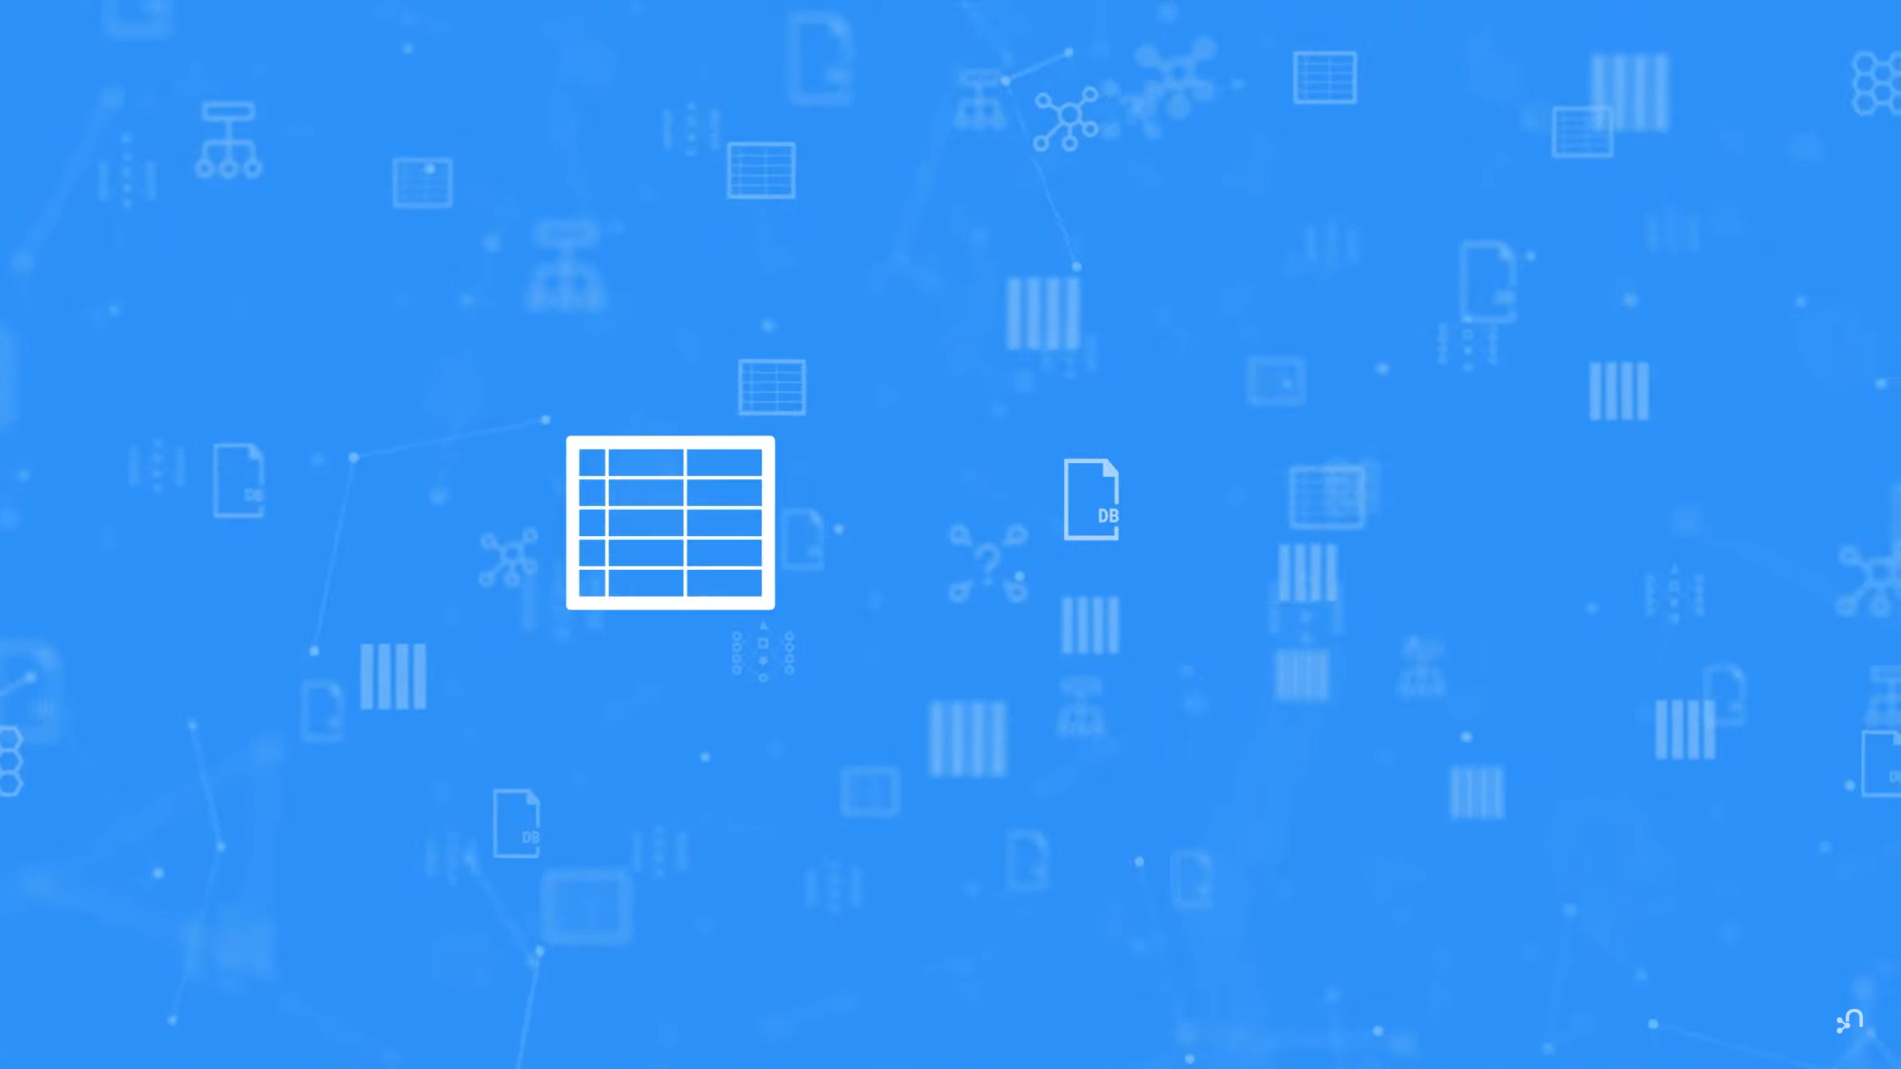

Slide 18
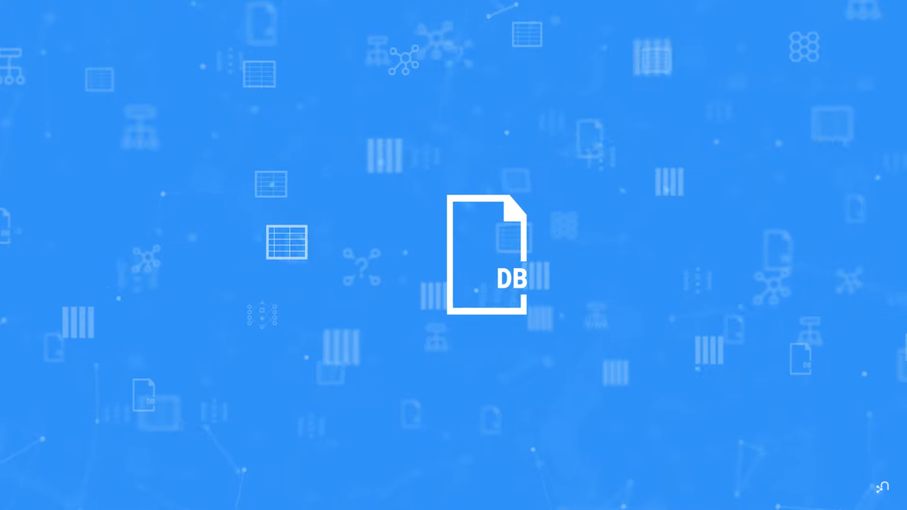

Slide 19
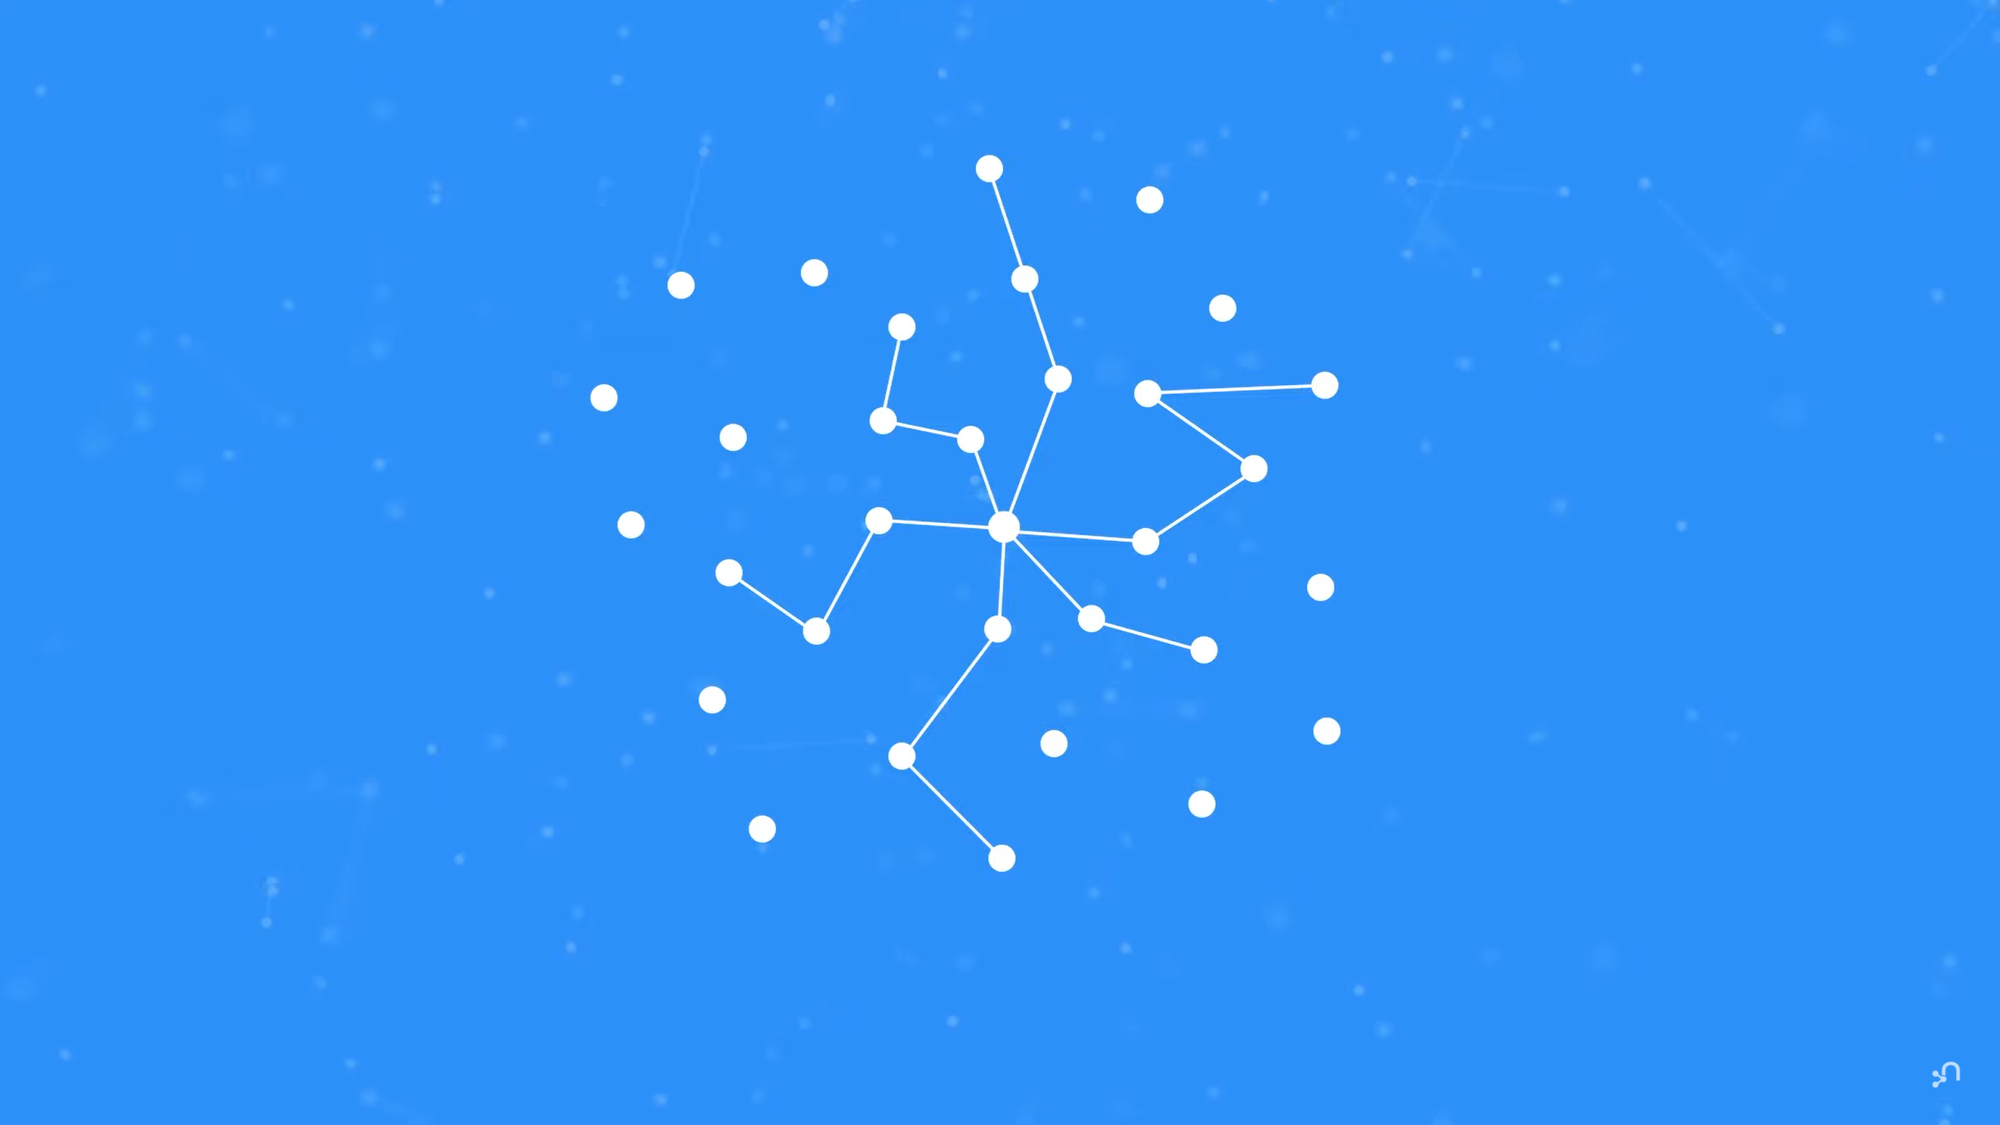

Slide 20
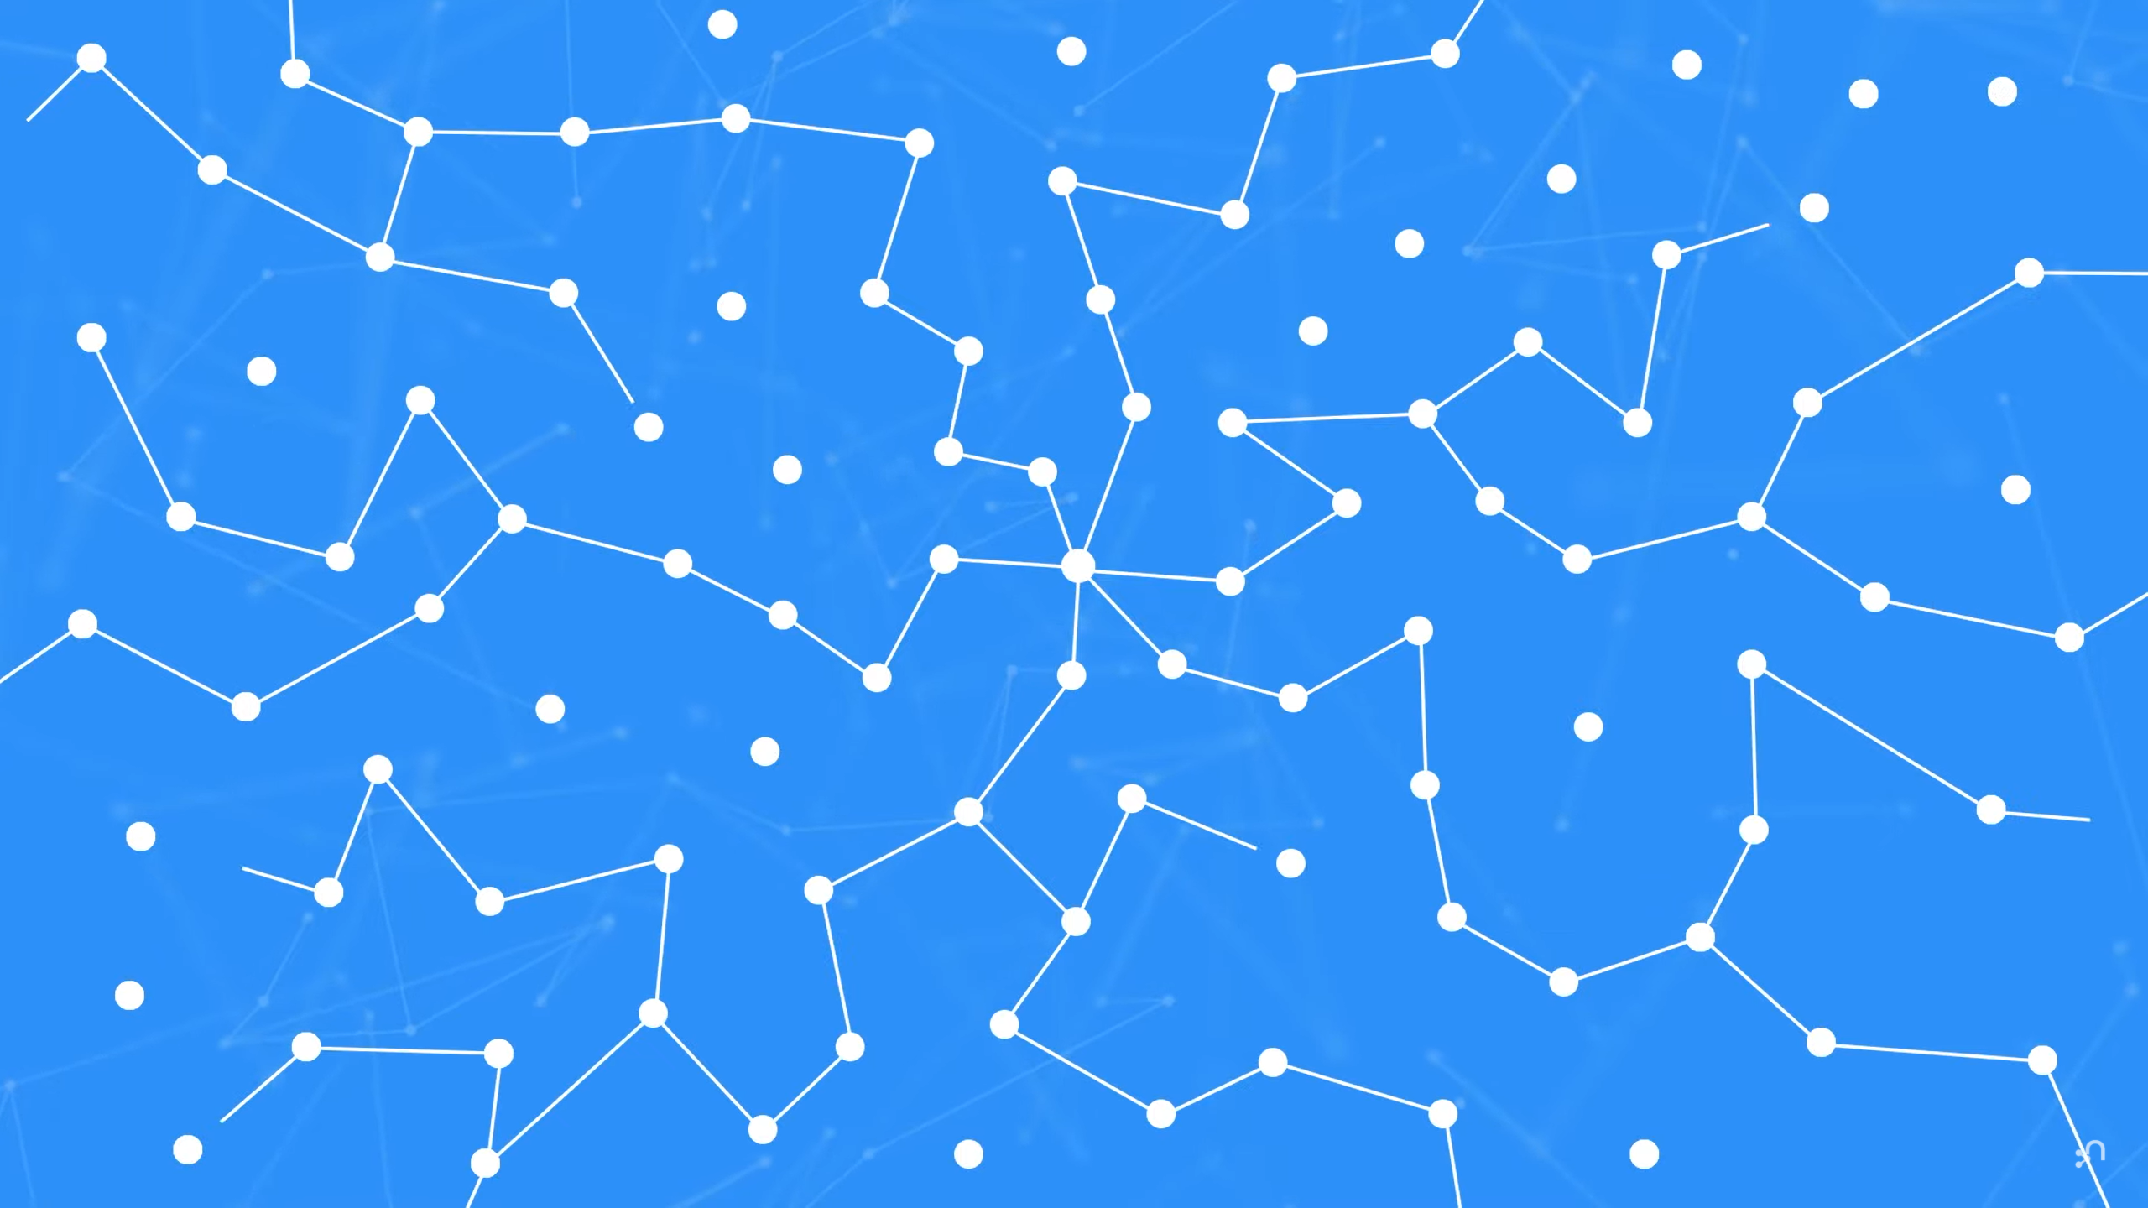

Slide 21
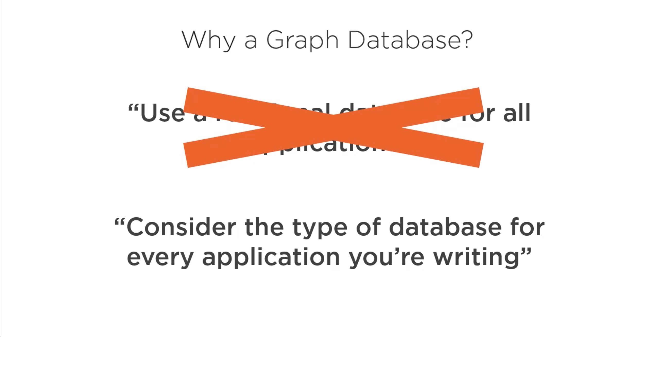

Slide 22
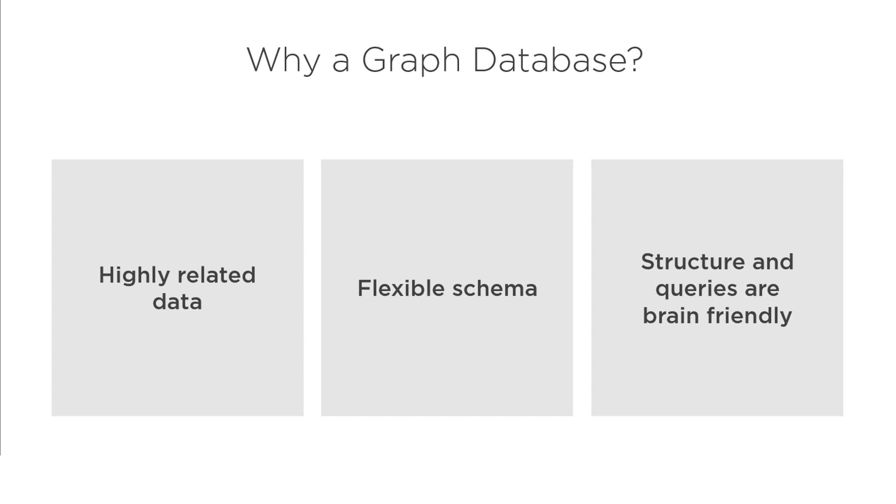

Slide 23
Document Database vs Graph Database

Slide 24
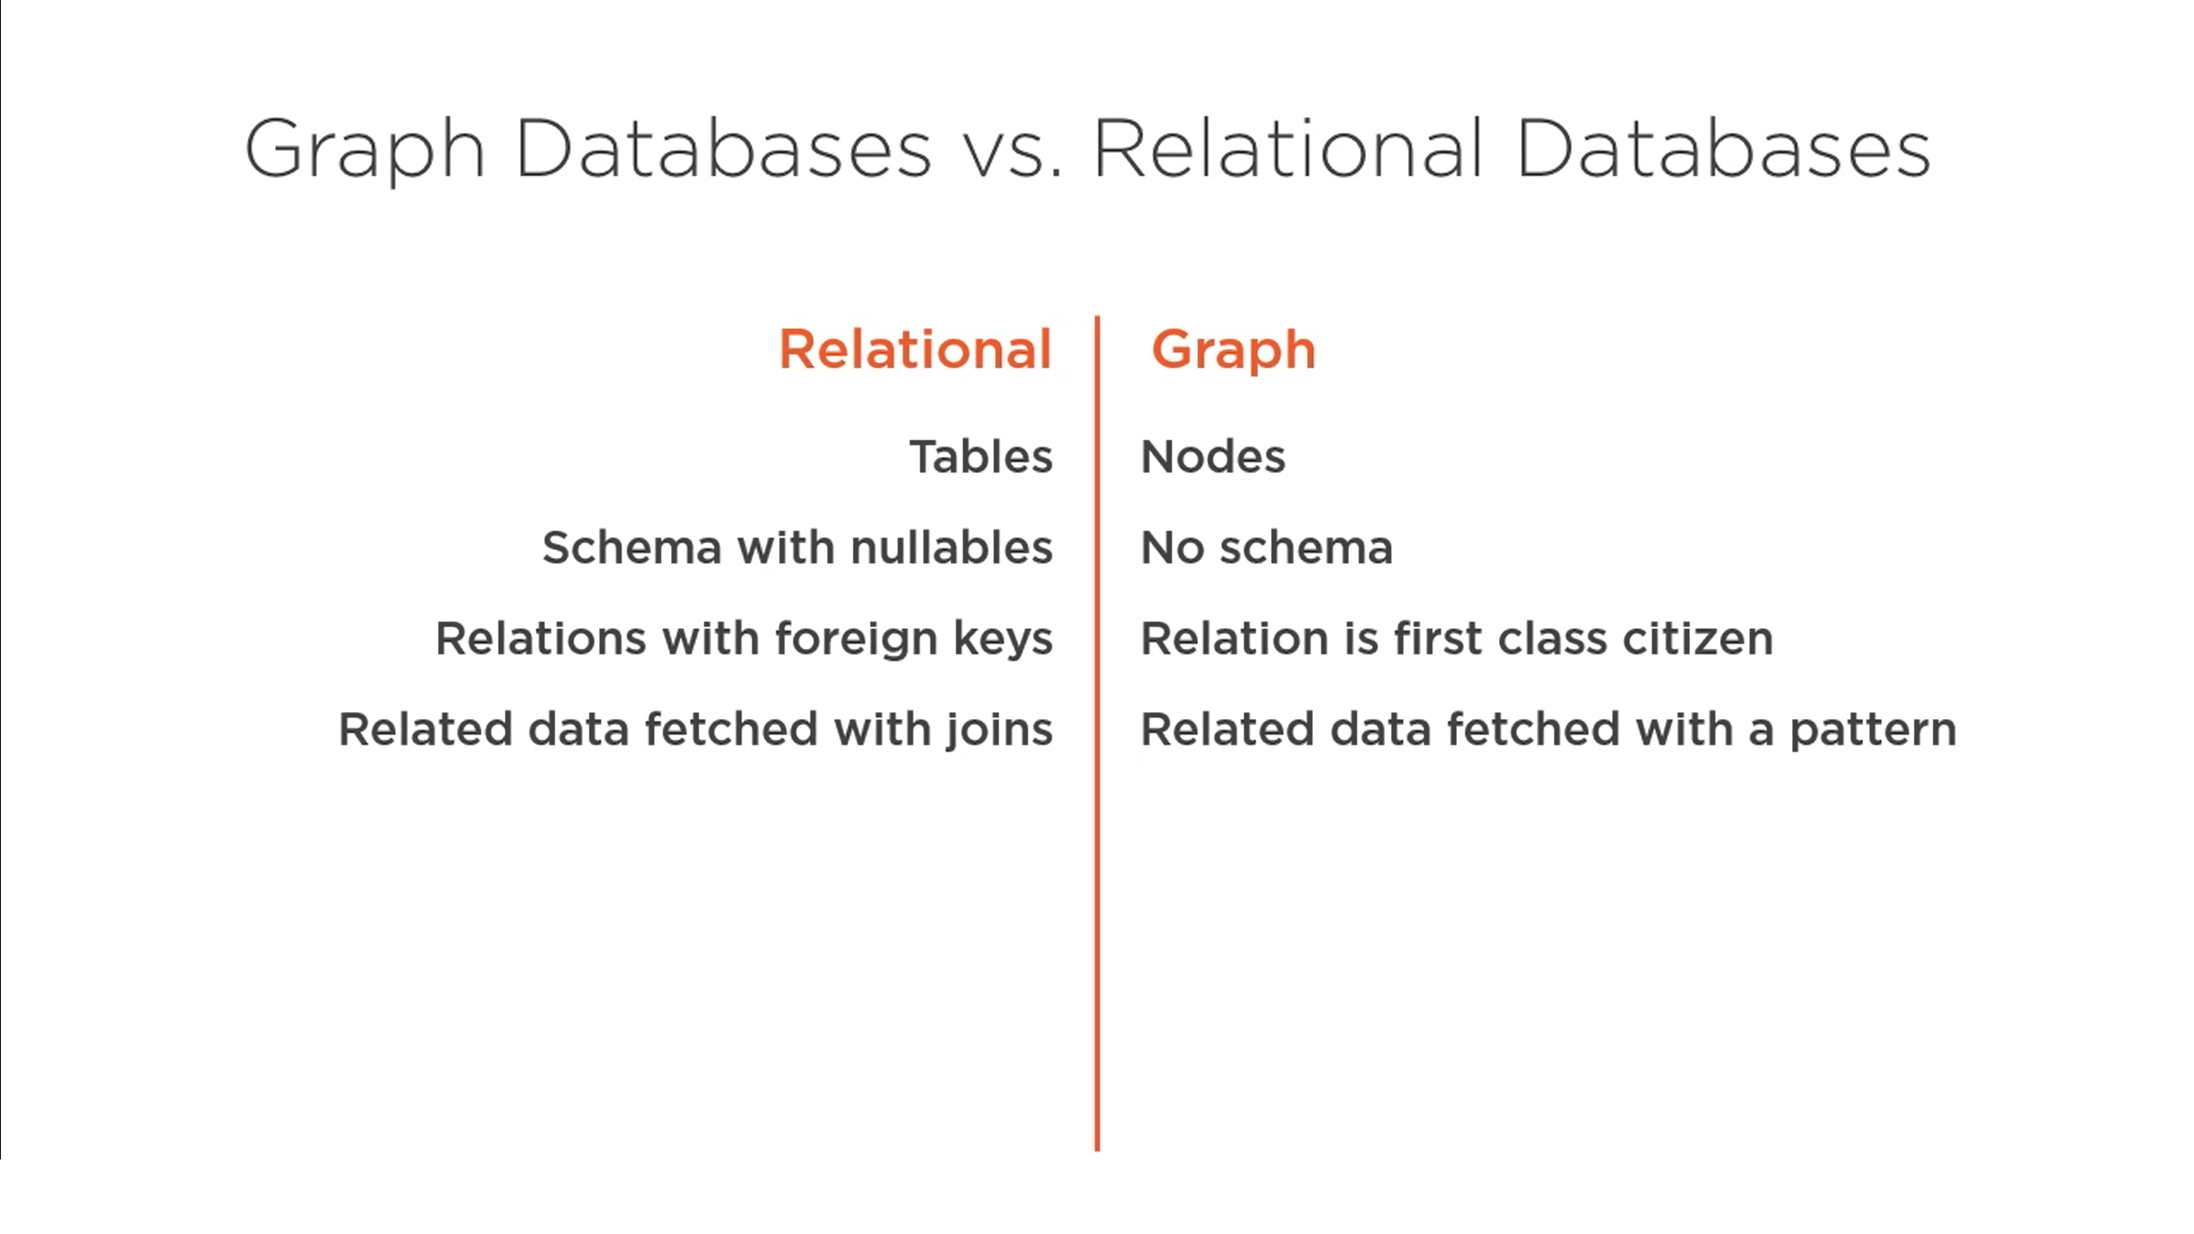

Slide 25
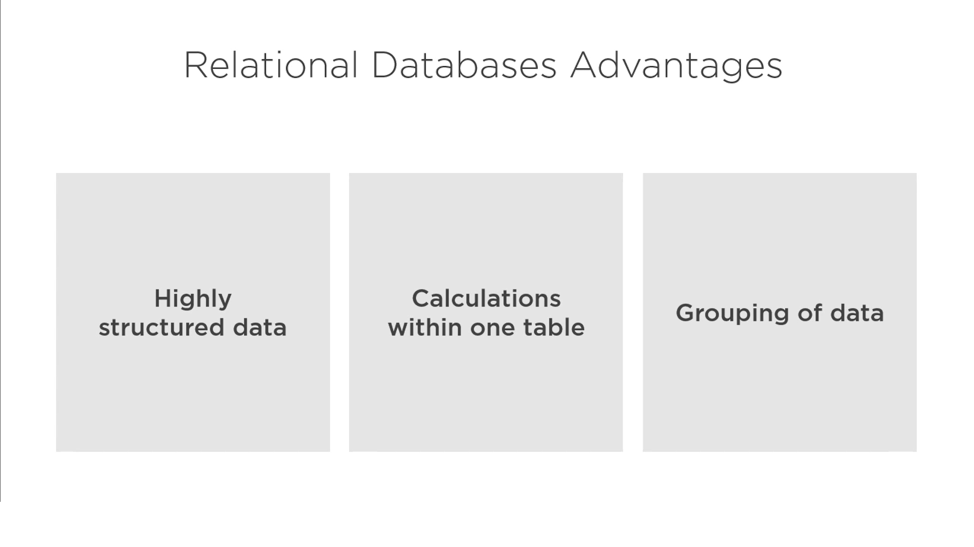

Slide 26
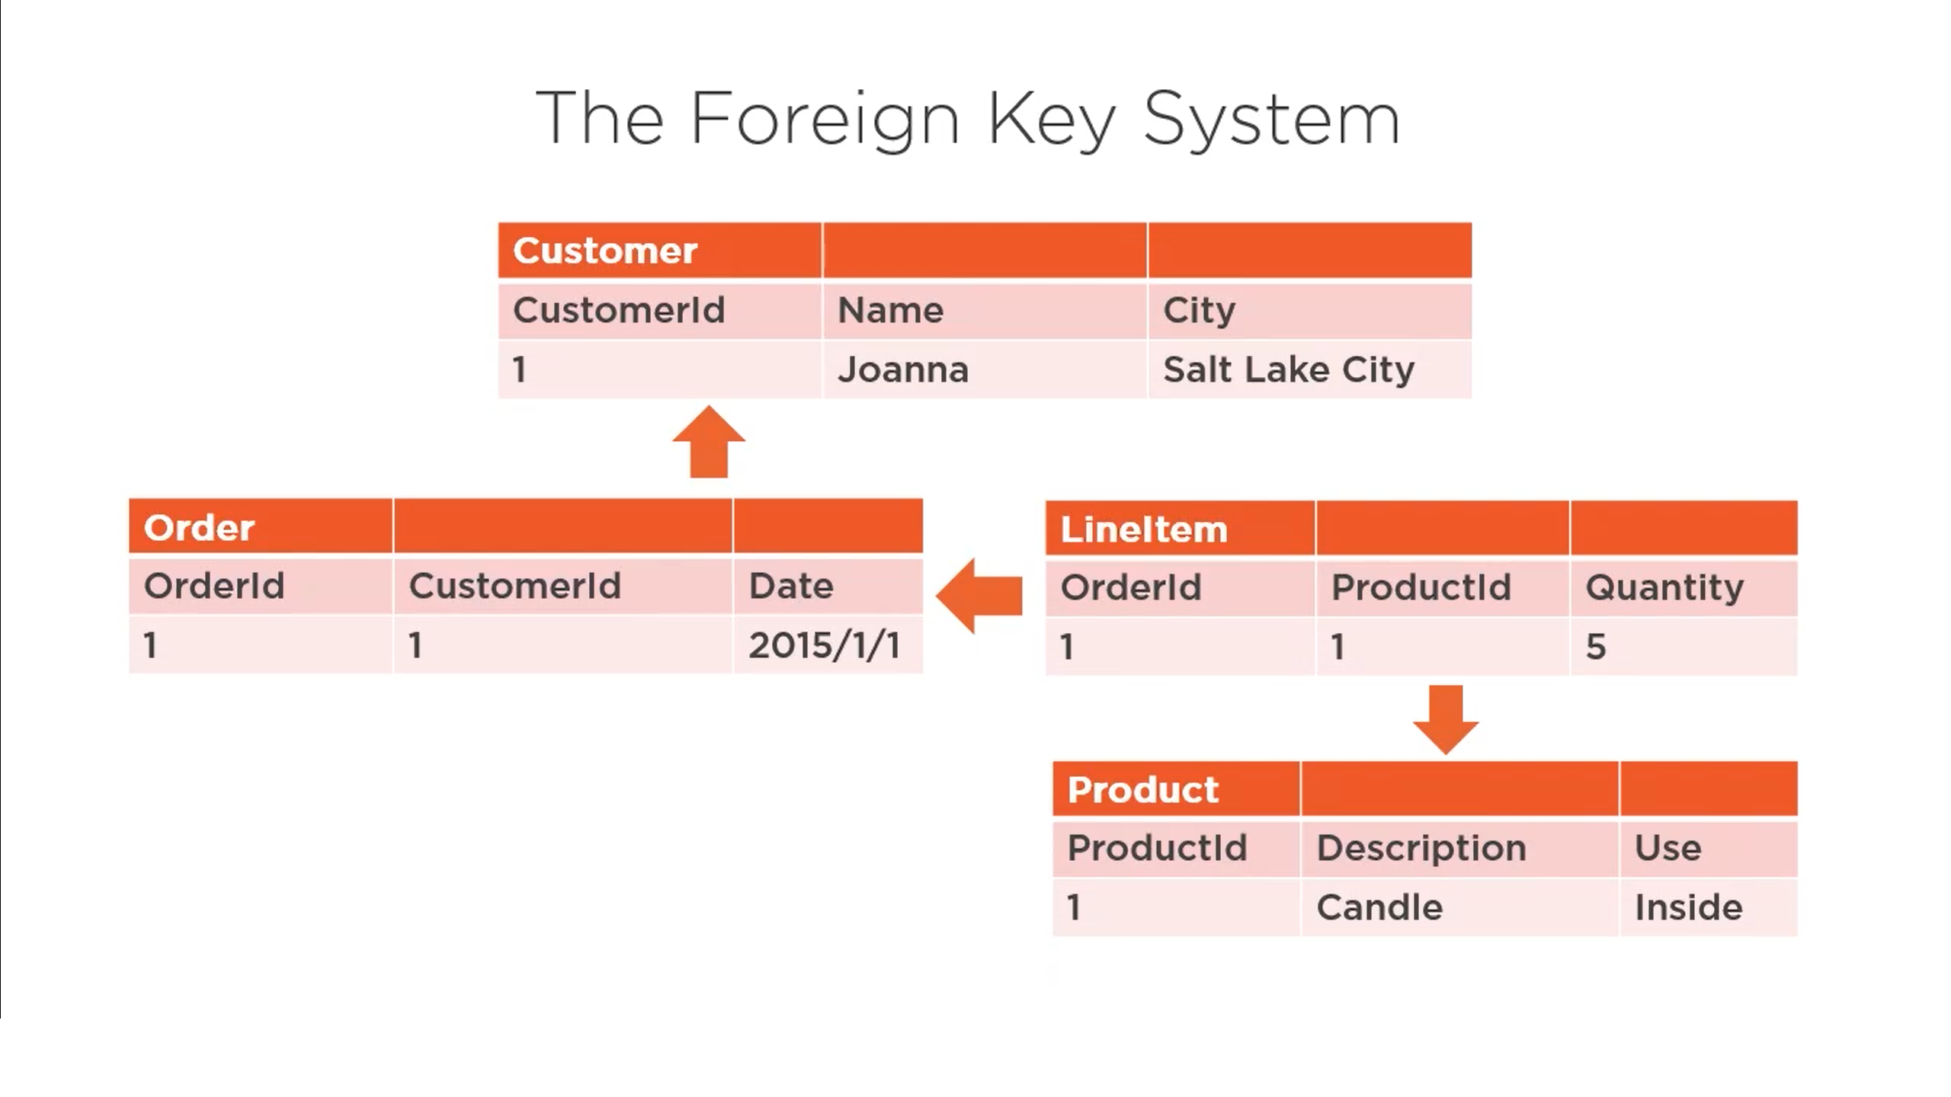

Slide 27
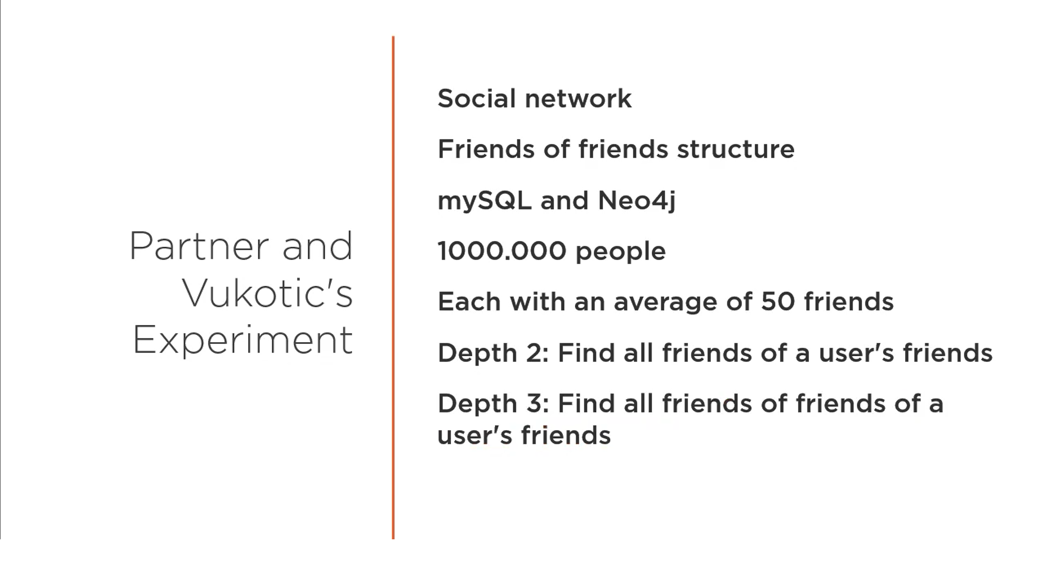

Slide 28
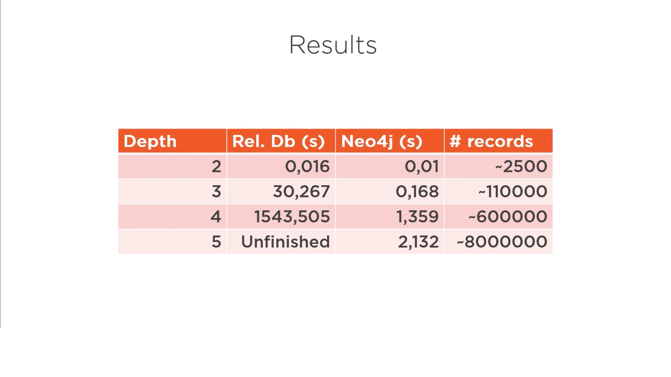

Slide 29
Document Database vs Graph Database

Slide 30
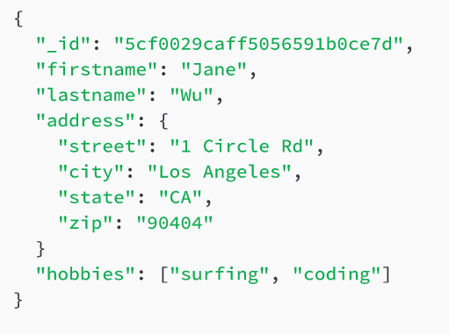

Slide 31
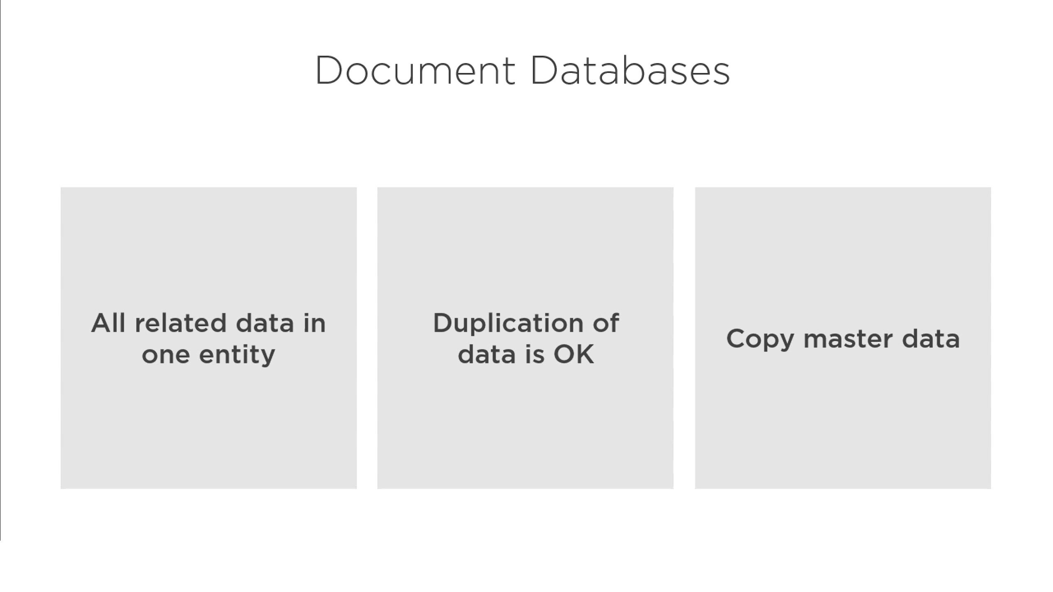

Slide 32
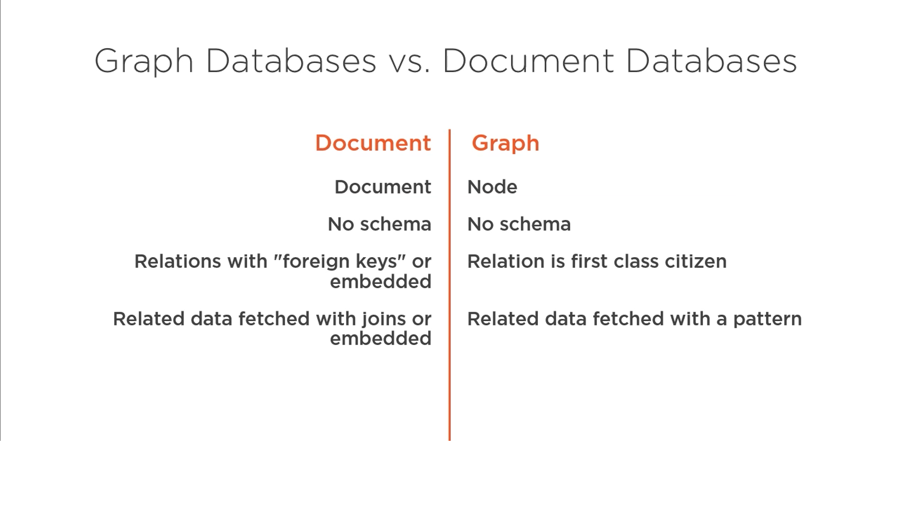

Slide 33
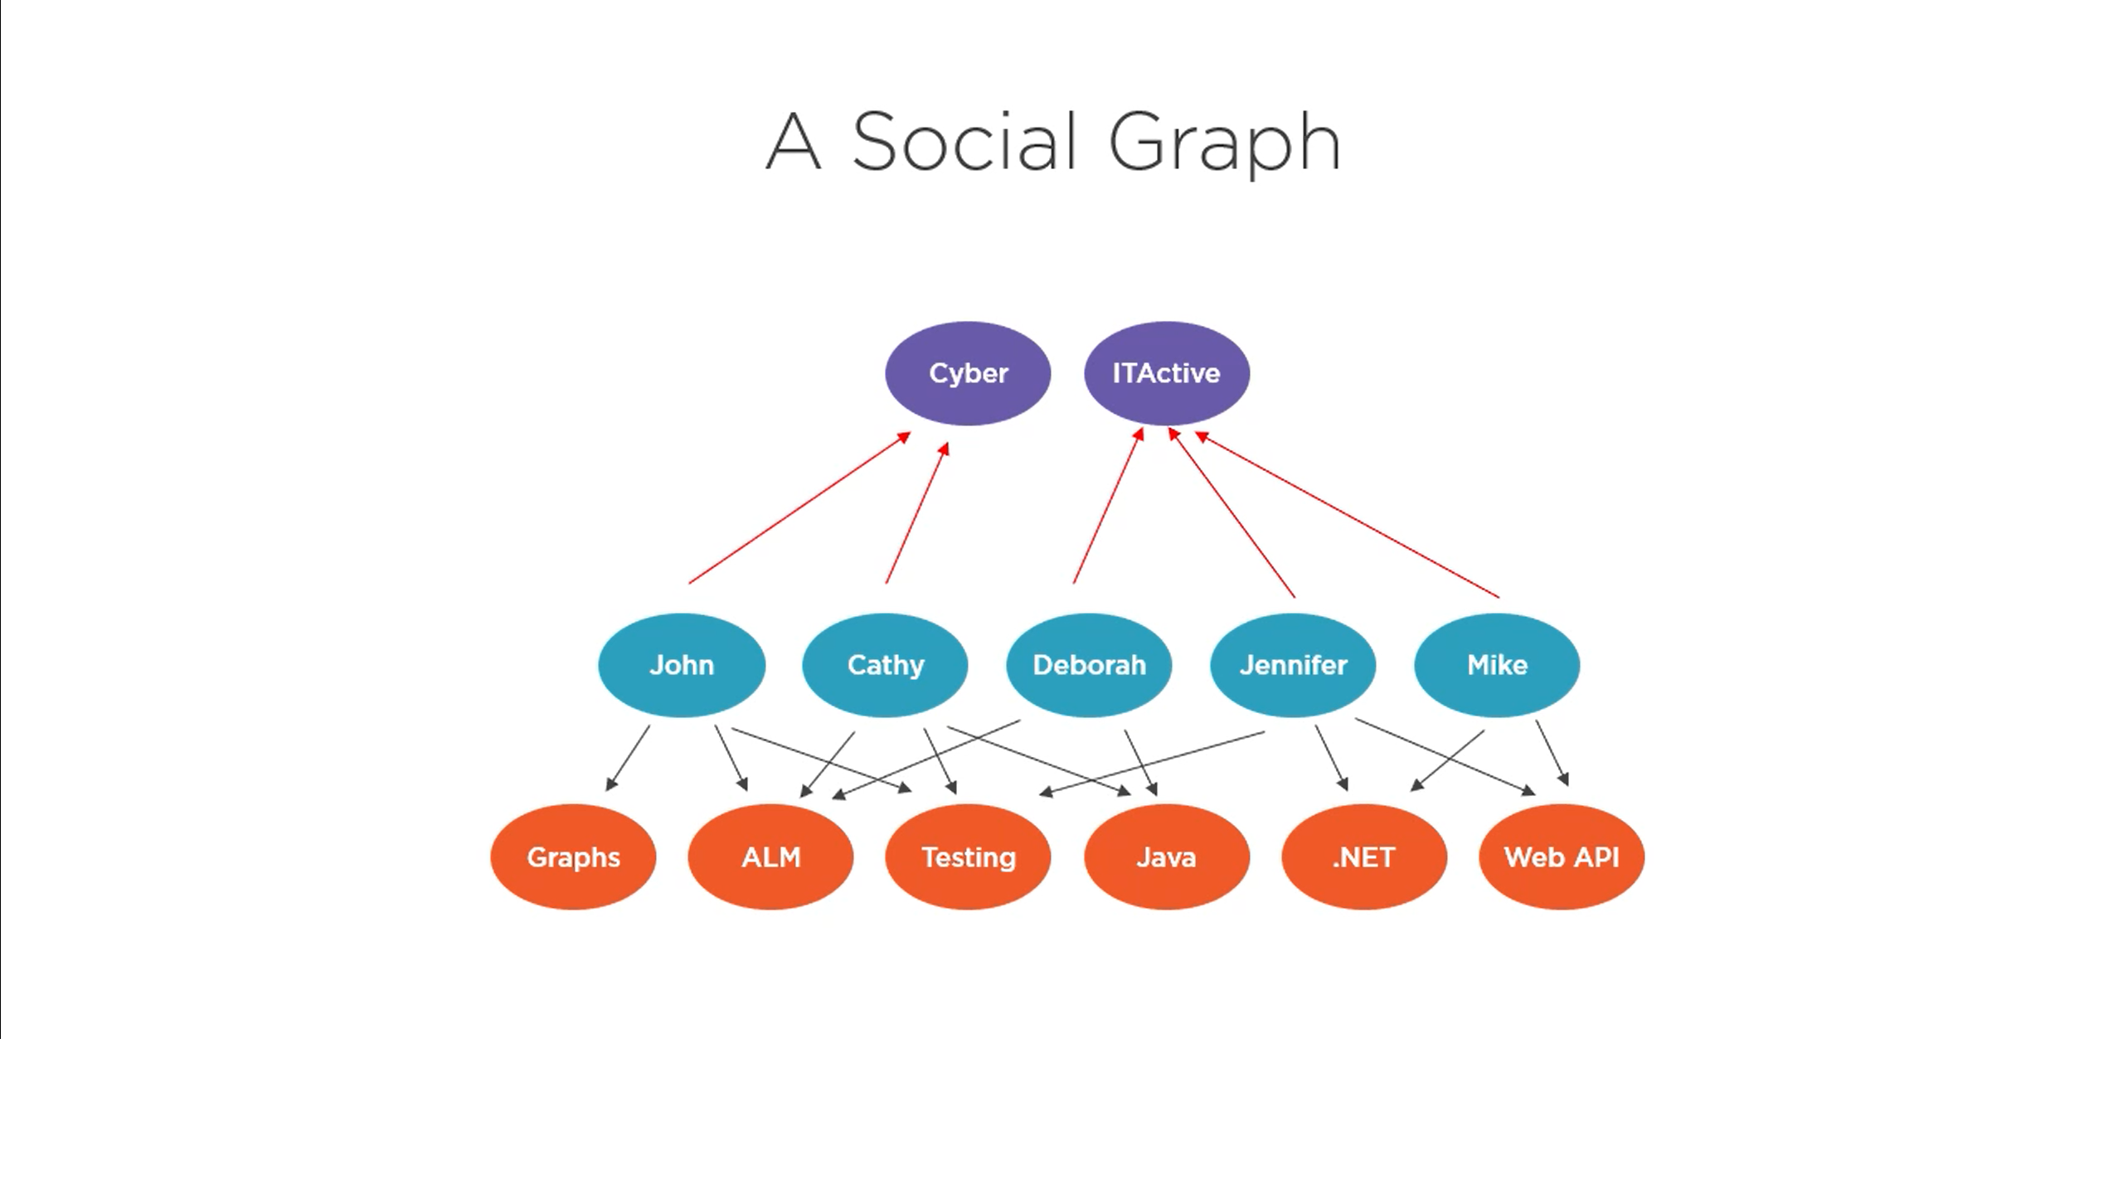

Slide 34
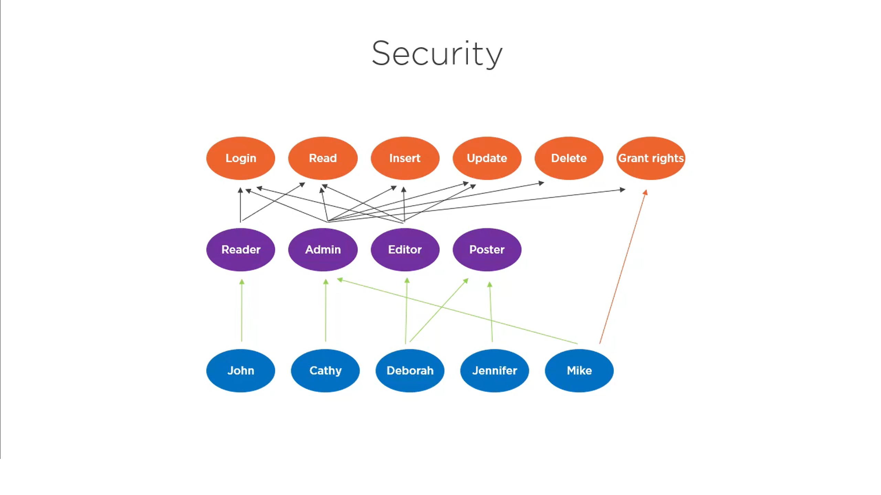

Slide 35
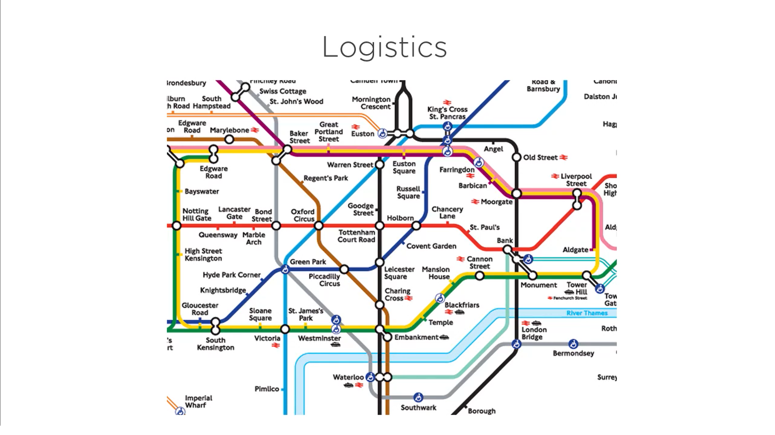

Slide 36
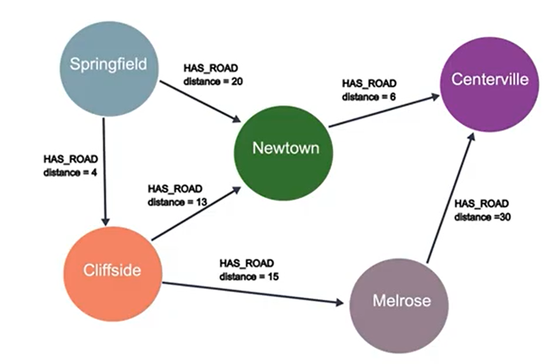

Slide 37
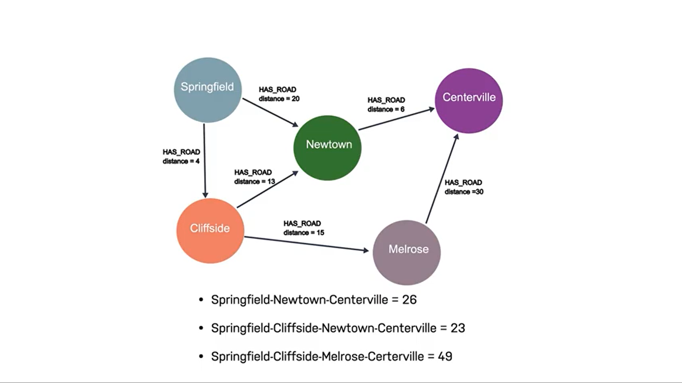

Slide 38
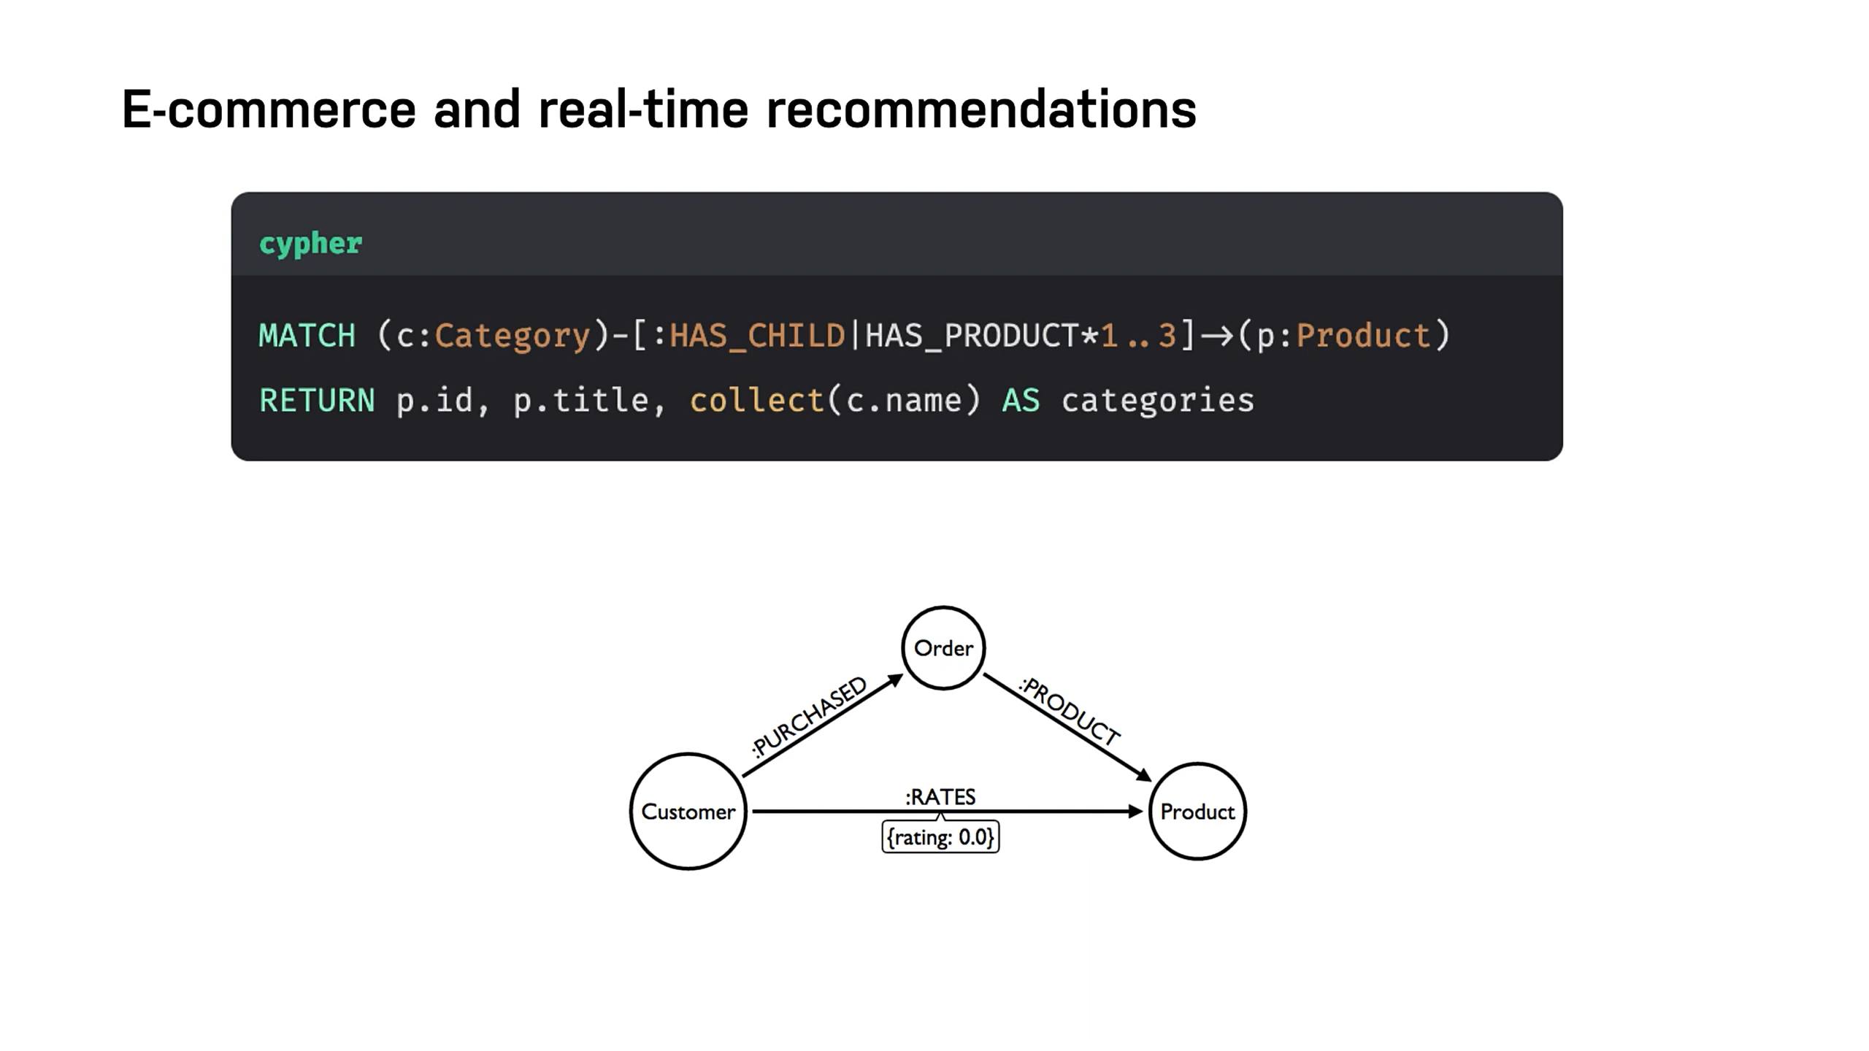

Slide 39
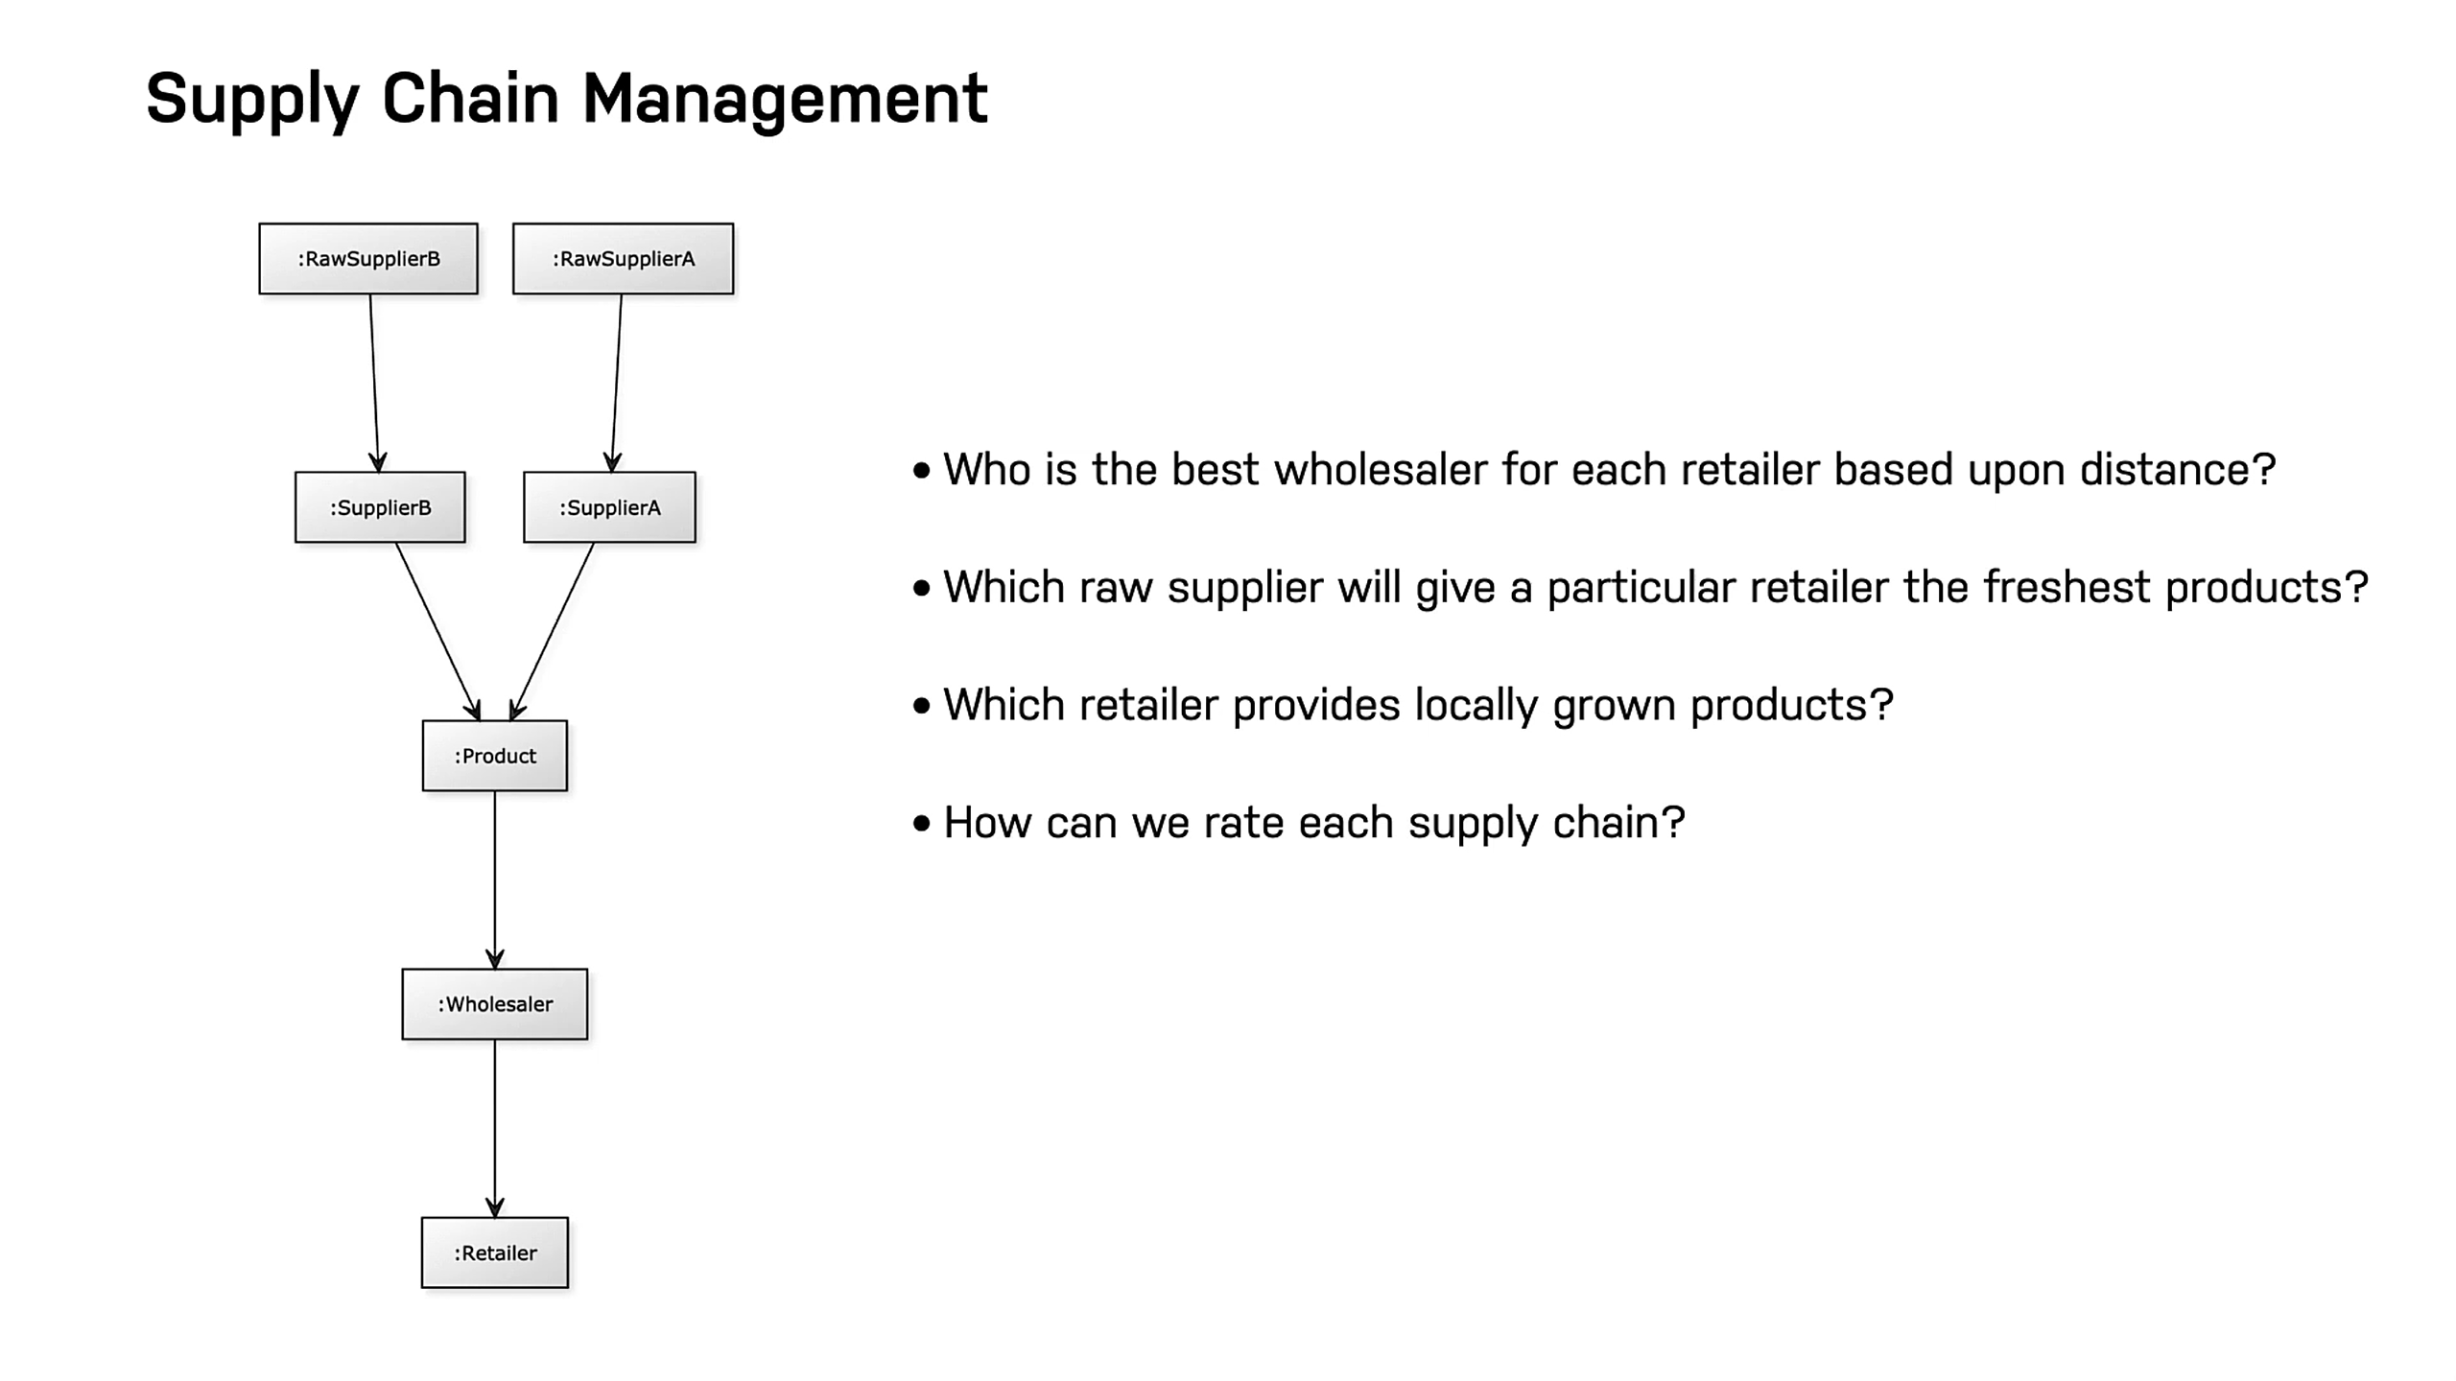

Slide 40

Introduction to new4j

Slide 45
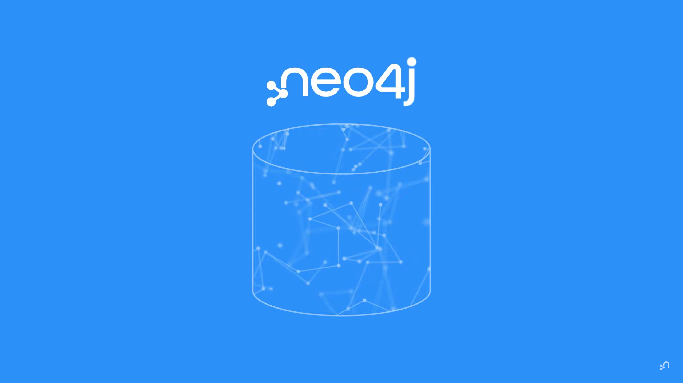

Slide 46
Unlike other databases, neo4j graph database, doesn’t need to
compute the relationships between your data at query time

Slide 47
What is new4j?
Neo4j is an open-source, NoSQL, native graph database that provides an ACID-compliant transactional backend for your applications that has been publicly available since 2007.
Neo4j is offered as a managed service via AuraDB.
But you can also run Neo4j yourself with either Community Edition or Enterprise Edition. The Enterprise Edition includes all that Community Edition has to offer, plus extra enterprise requirements such as backups, clustering, and failover abilities. Neo4j is written in Java and Scala, and the source code is available on GitHub.

Slide 48
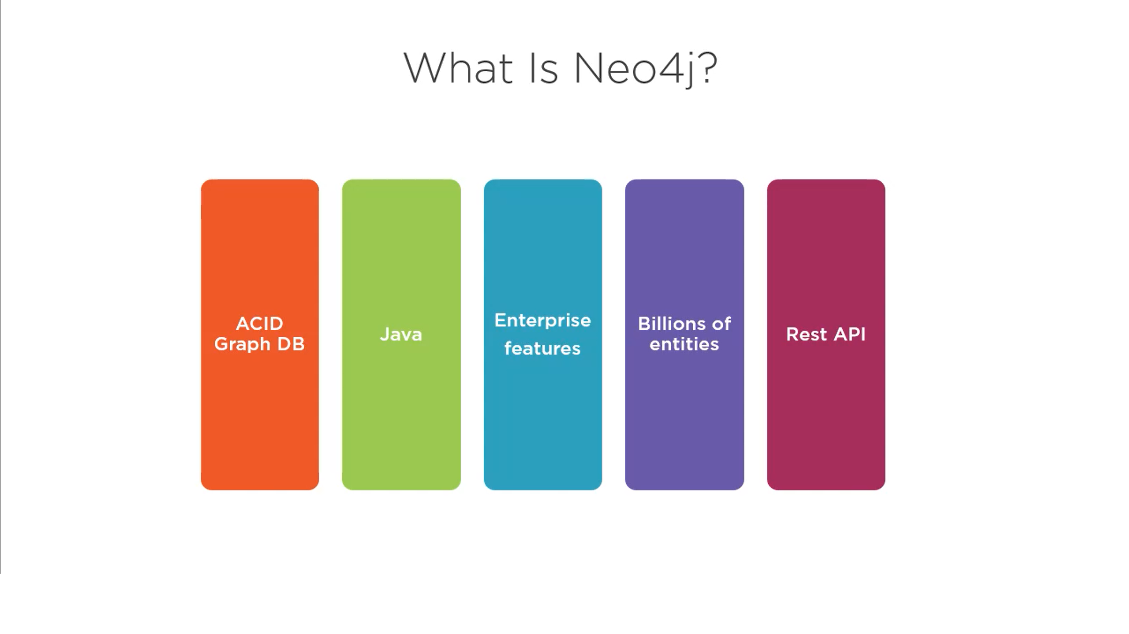

Slide 49
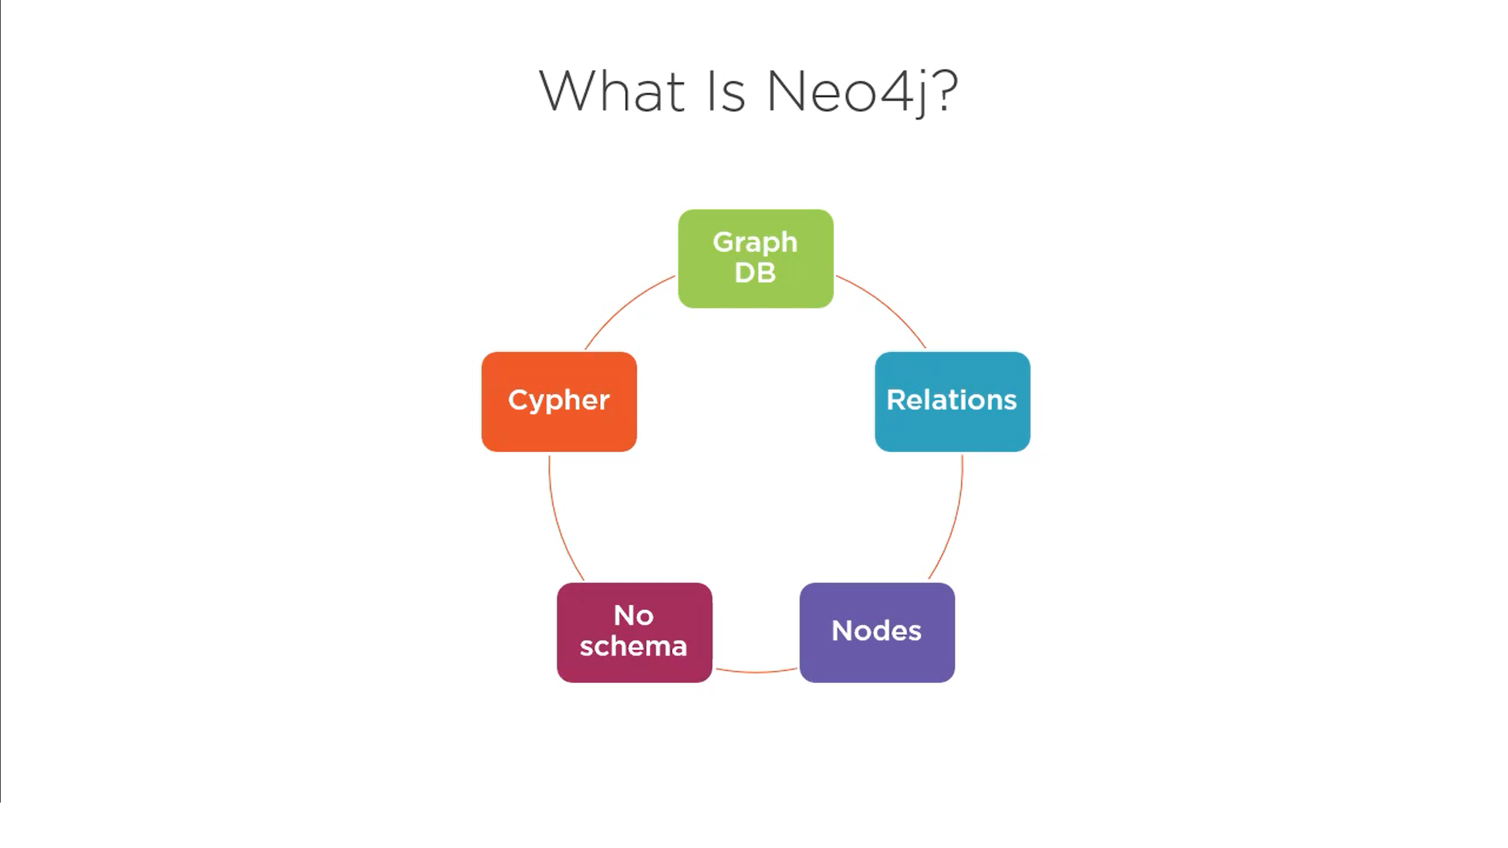

Slide 50
What makes Neo4j the easiest graph to work with?
Cypher, a declarative query language similar to SQL, but optimized for graphs. Now used by other databases like SAP HANA Graph and Redis graph via the openCypher project.
Constant time traversals in big graphs for both depth and breadth due to efficient representation of nodes and relationships. Enables scale-up to billions of nodes on moderate hardware.
Flexible property graph schema that can adapt over time, making it possible to materialize and add new relationships later to shortcut and speed up the domain data when the business needs change.
Drivers for popular programming languages, including Java, JavaScript, .NET, Python, and many more.

Slide 51
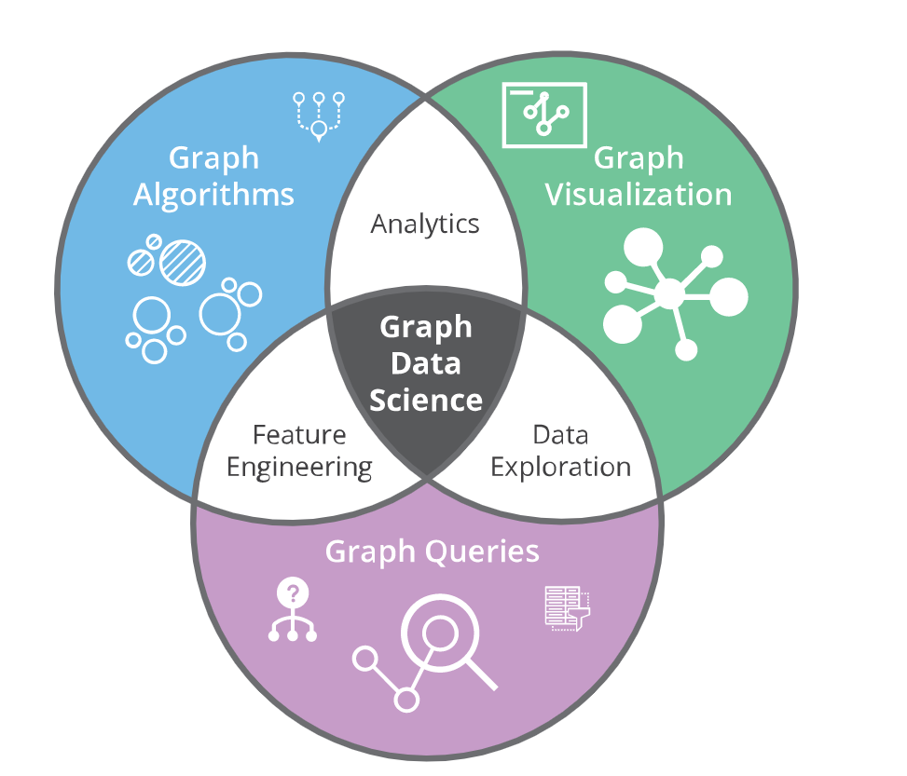
Graph Data Science Library
Businesses use these insights to make valuable predictions, such as
Pinpointing interactions that indicate fraud
Identifying similar entities or individuals
Finding the most influential elements in patient or customer journeys
How to minimize the impact of IT, phone or other network outages.
Neo4j Graph Data Science (GDS) Library uses the relationships and network structures in data to help data scientists address complex questions about system dynamics and group behaviour.
https://neo4j.com/product/graph-data-science/?ref=product

Slide 52
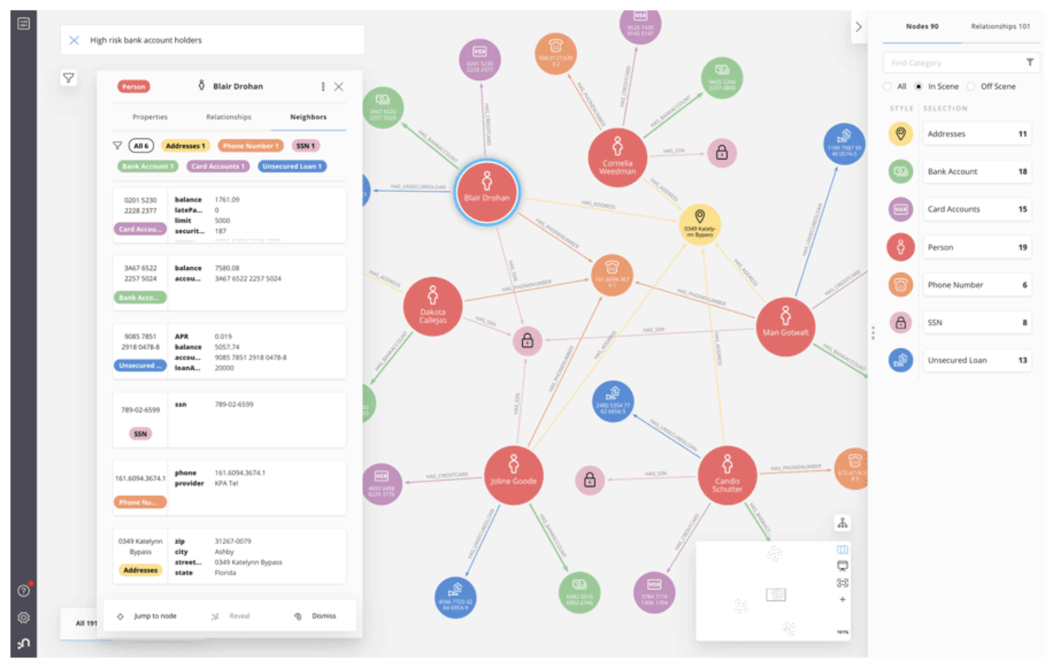
Neo4j Bloom
Neo4j Bloom is an easy-to-use graph exploration application for visually interacting with Neo4j graphs. Bloom gives graph novices and experts alike the ability to visually investigate and explore graph data from different business perspectives.
Bloom’s illustrative, codeless search-to-visualization design makes it the ideal interface for
Fostering communication between peers
Managers and executives
Sharing the work of graph development and analytics teams

Slide 53
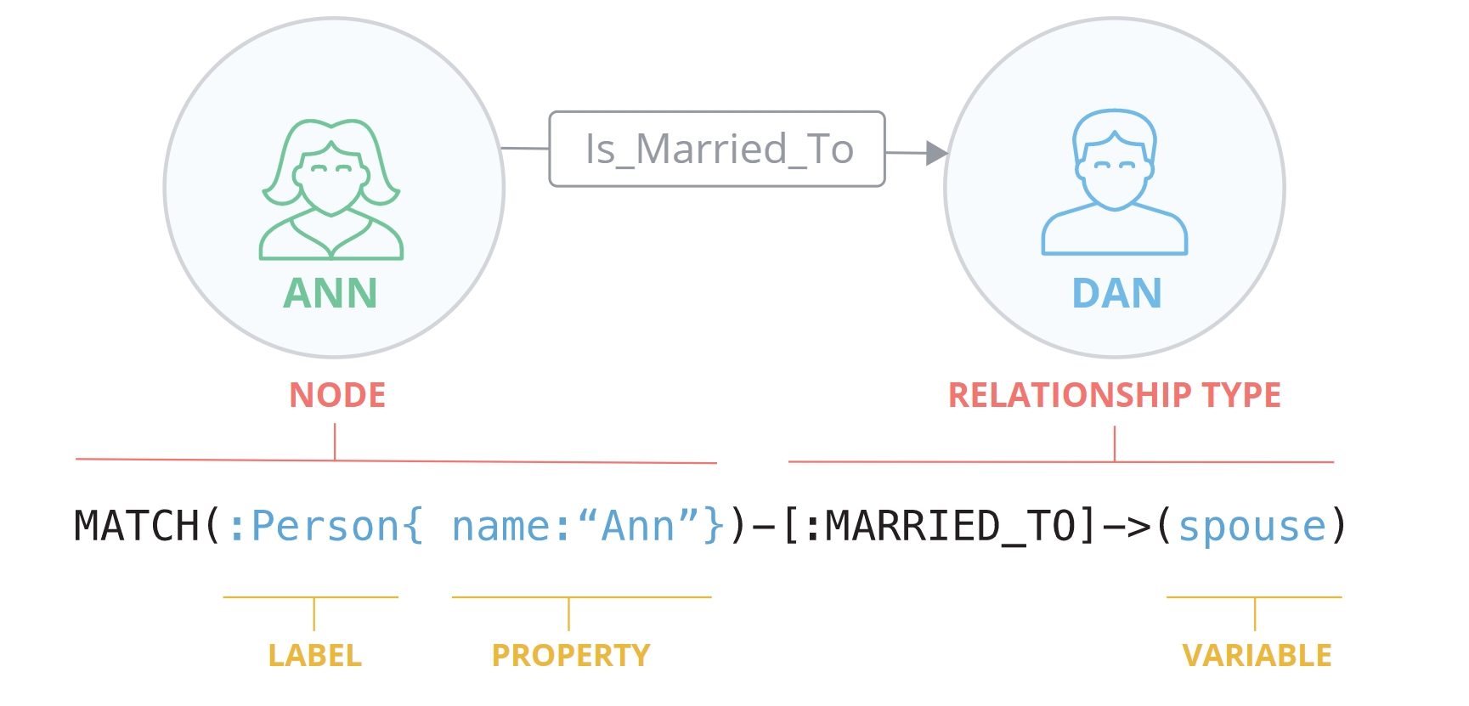
Cypher Query Language
With Neo4j, connections between data are stored – not computed at query time. Cypher is a powerful, graph-optimized query language that understands, and takes advantage of, these stored connections.
Cypher is inspired by SQL, with the addition of pattern matching borrowed from SPARQL. It uses simple ASCII symbols to represent nodes and relationships, making queries easy to read and understand.

Slide 54
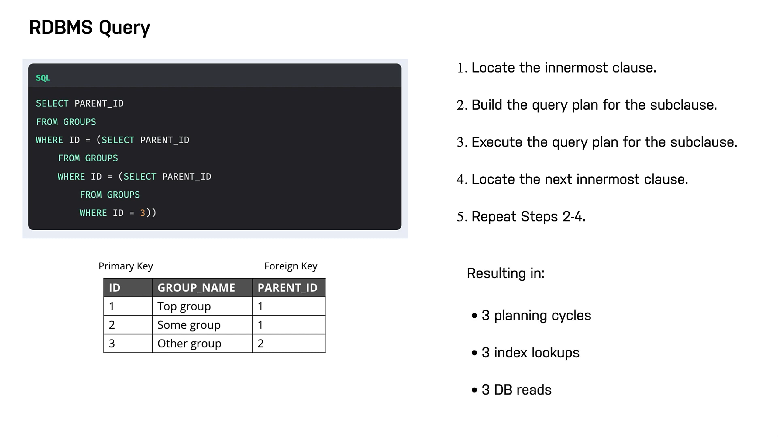

Slide 55
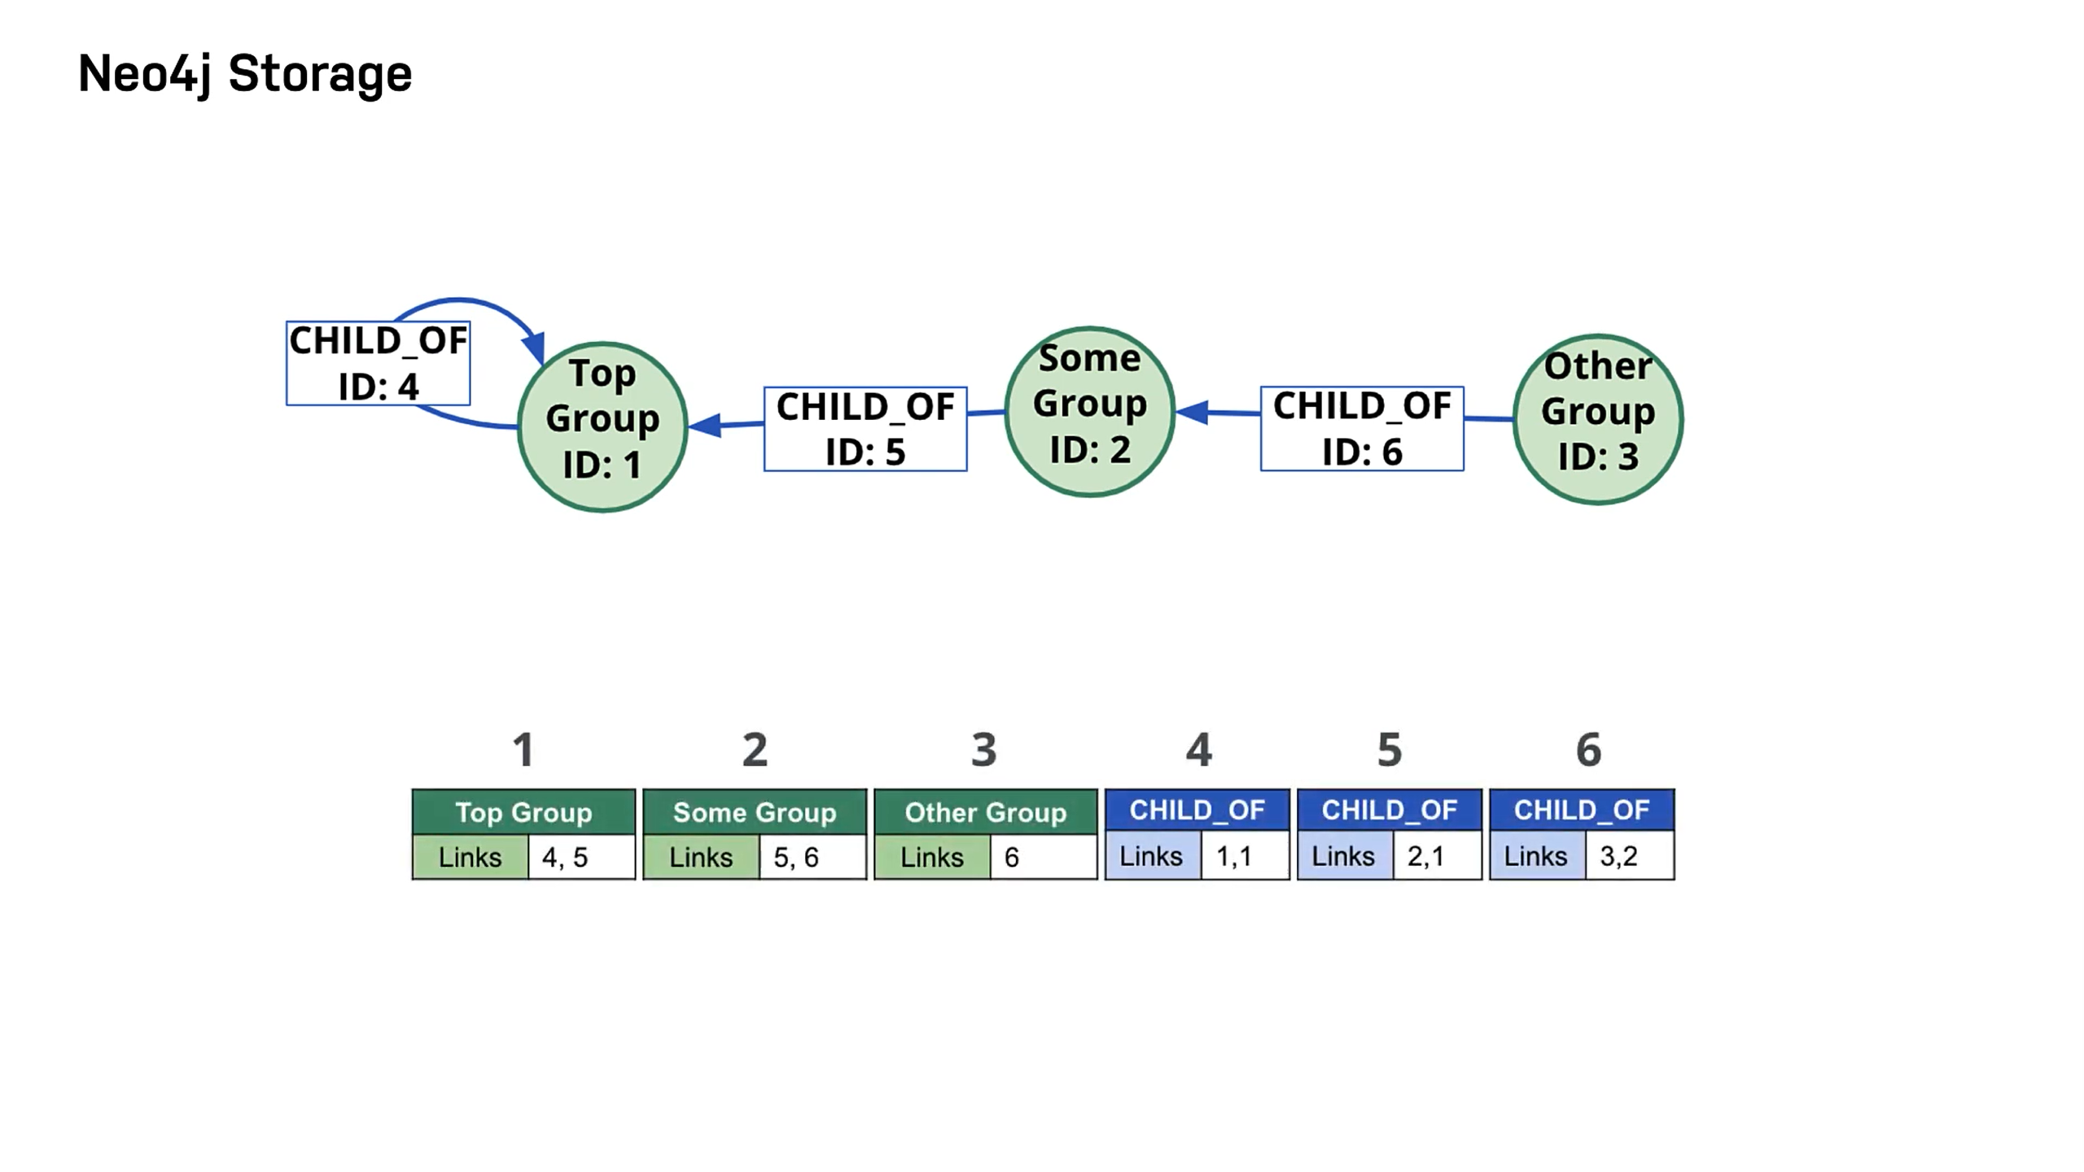

Slide 56
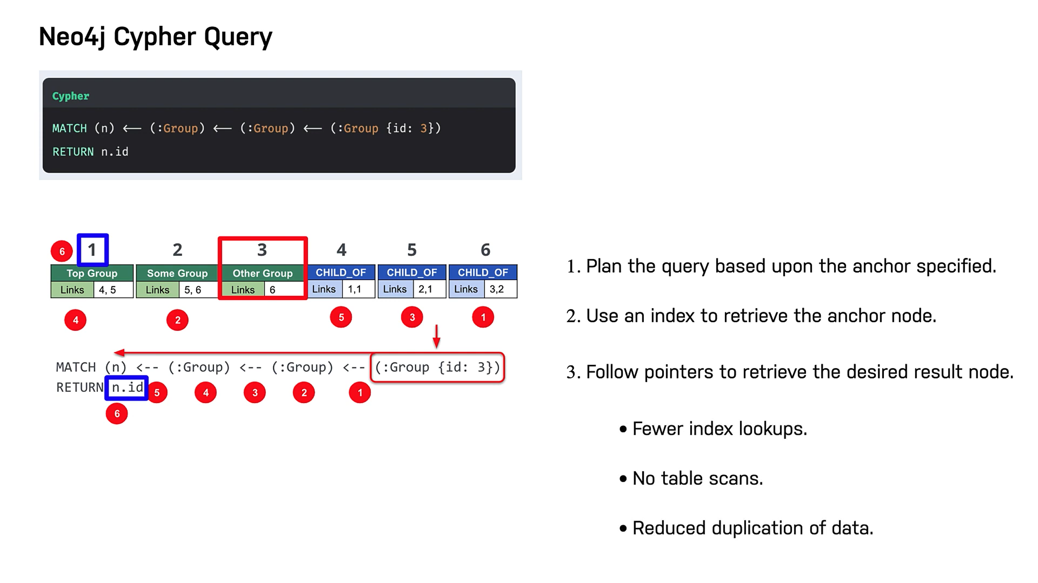

Slide 57
Where and How is Neo4j Used?
Neo4j is used today by thousands of startups, educational institutions, and large enterprises in all sectors including financial services, government, energy, technology, retail, and manufacturing. From innovative new technology to driving businesses, users are generating insights with graph, generating new revenue, and improving their overall efficiency.

Slide 58
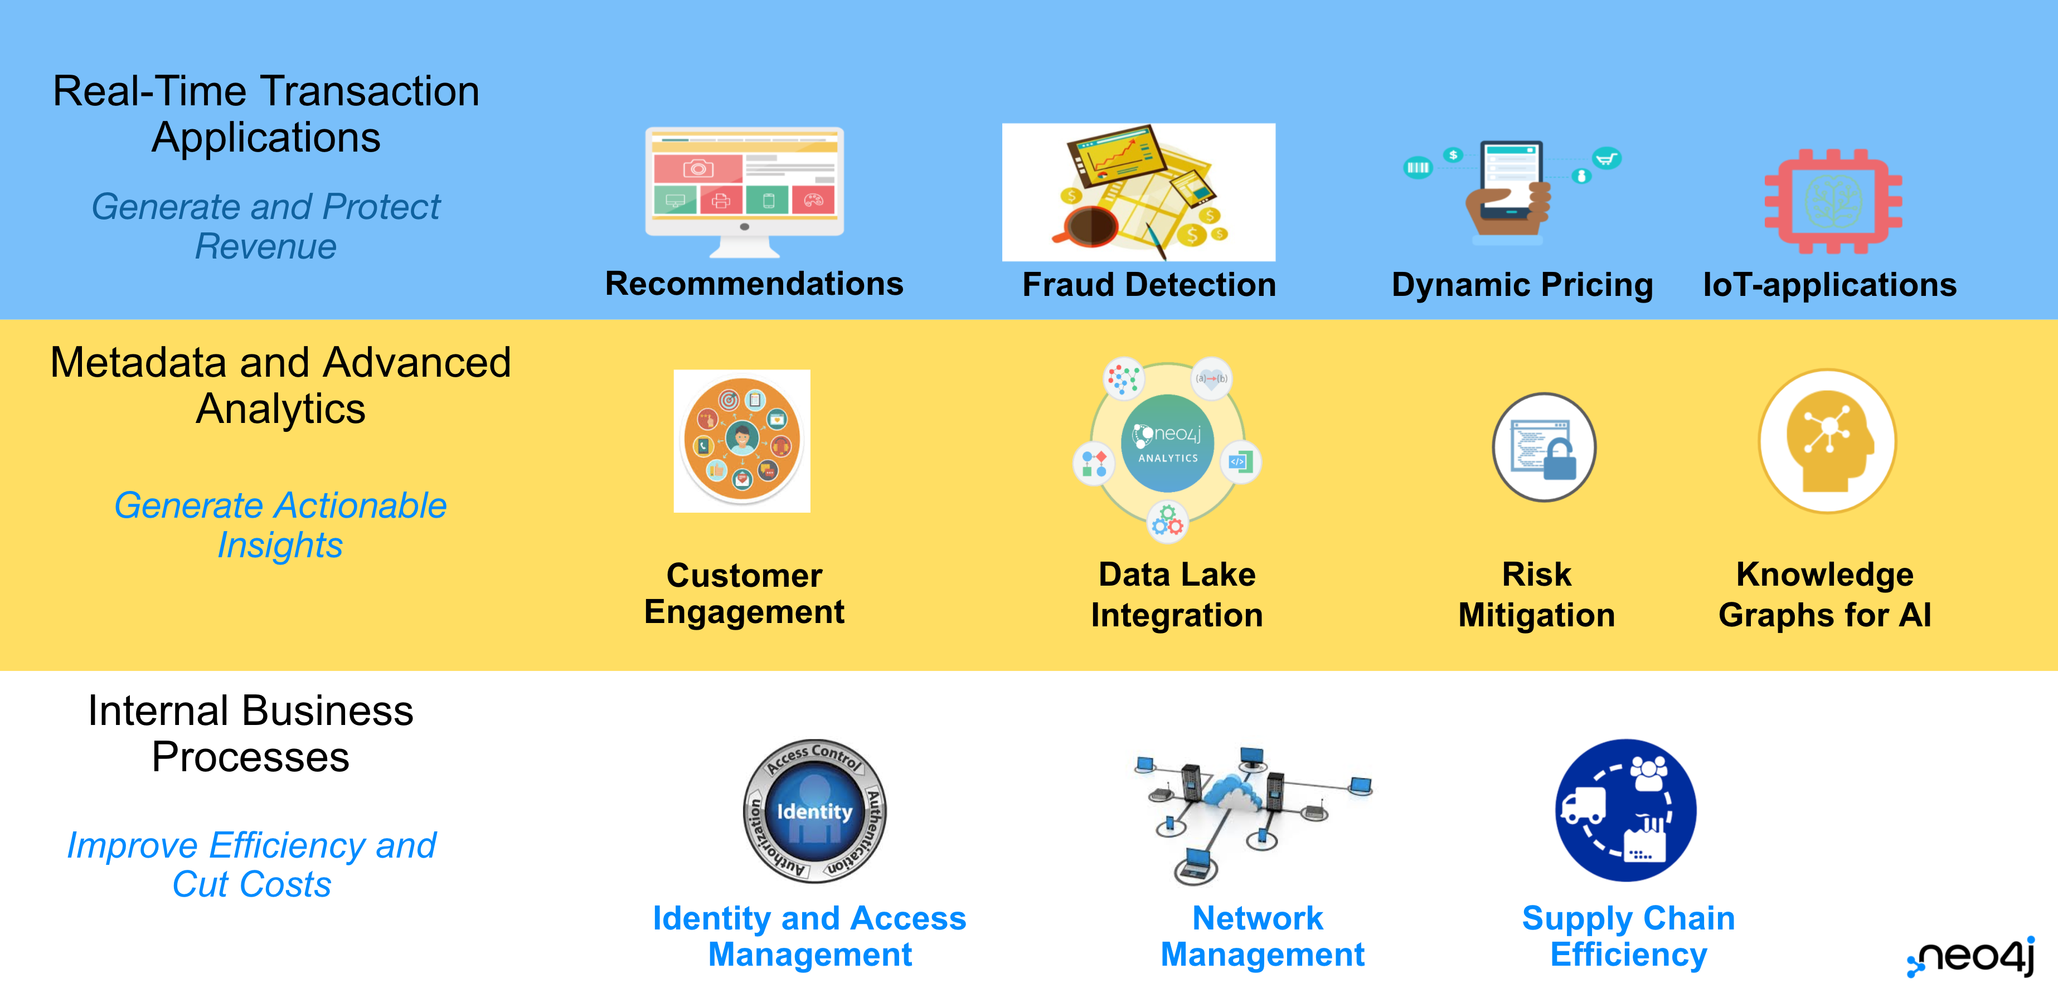

Slide 59


Slide 60
Environment Setup

Slide 61

Download neo4j Desktop
https://neo4j.com/download/

